Slide 1
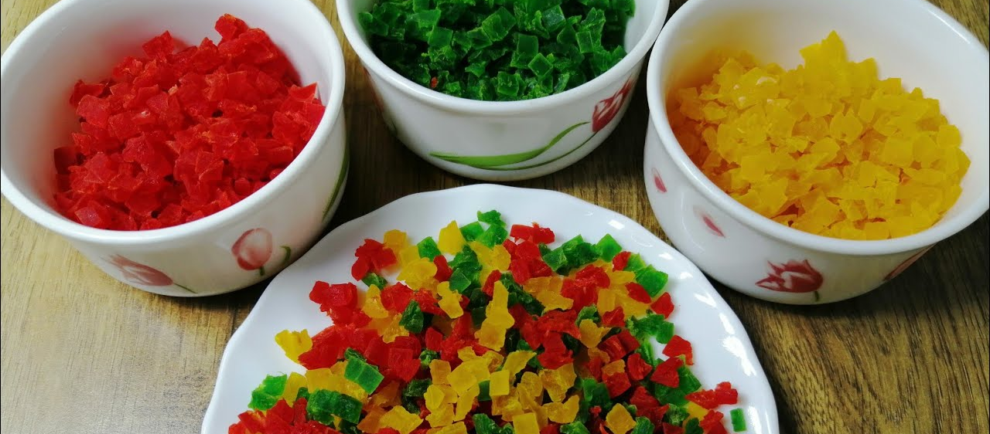

PROJECT ON ENTERPRENEURSHIP
DEVELOPMENT OF TRUTIFRUTI MANUFACTURING PLANT
GUIDE BY:
DR. APURBA GIRI¹,
AYAN MONDAL² ,
Head of Nutrition department ¹
Assistance professor ²
^{Dept. of Nutrition}
PROJECTED BY:
SANJUKTA BHANJA,
Student of B.Voc Food Processing 6th sem
Dept. of Nutrition
MUGBERIA GANGADHAR MAHAVIDYALAYA
MUGBERIA GANGADHAR MAHAVIDYALAYA

Slide 2
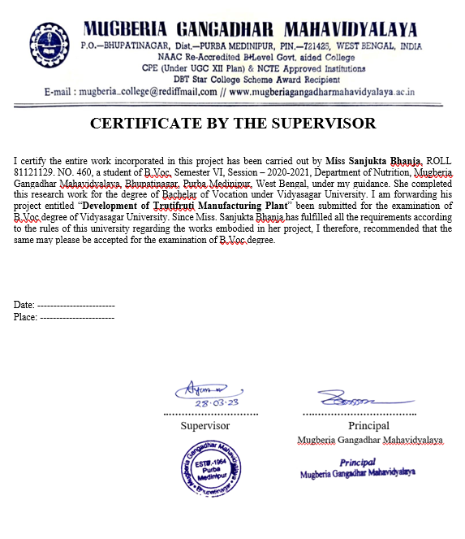
.

Slide 3
OUTLINES
Introduction
Scope of Tutifruti food item
Market Survey
Installed capacity of processing plant
Requirement of Raw material, Machinery & Licenses
Manufacturing process
Plant layout
Capital investment &man power
Waste utilization
Product pricing
Target market
Future Revenue
Conclusion

Slide 4
INTRODUCTION
Tutifruti is a colorful confection containing variously chopped and candied fruits, or an artificially created flavoring simulating the combined flavor of different fruits.
Papaya is the second most nutritive food to Mango. Tutifruti is made
from unripe papaya fruit and contains a good amount of sugar.
The countries with the largest papaya production are India and Brazil
followed by Nigeria, Indonesia, and Mexico.

Slide 5
SCOPE OF TRUTIFRUTI FOOD ITEMS
Tutifruti is made by impregnating fruits with flavor & taste along with attractive color. It provides attractiveness as well as nutritive value to many food items.
Bakery products: Like buns, cakes, bread, pizza, rolls etc.
Ice creams & puddings: Fruity ice cream, jellies and puddings.
In sweet/sour preparations at home: In payasam, curd rice
Chewing pans; Sweet pans
Salads: Along with dry fruits
Mouth freshener

Slide 6
MARKET SURVEY
Candied fruits notably Tutifruti is quite popular. As the consumption of bakery goods is on the increase, the demand for Tutifruti can also be expected to rise at the same pace. Papaya Tutifruti and other fruit candies can find a good market outside India also.
Competitors: Through market survey, I observed my competitors and understood what they offer, how they market themselves, and how i can differentiate my business.
Some competitors companies-------
Dadaji Food Products Pvt. Ltd. ( Jorabagan, Kolkata)
Prasad Food Products (Belgachia, Kolkata)
New Gupta Products (Sapui Para , Kolkata)

Slide 7
LICENCE & CERTIFICATE REQUIRED FOR BUSINESS SET UP
Food products order licenses (FPO)
NOC paper (form state pollution control)
Trade license
GST
FSSAI Licenses
Registration for trademark
Fire Registration
BIS Certificate
ISO 14075
ISO 22000

Slide 8

A. Area:
The total area also requirement for the envisaged project is estimated at 1200-2000 square feet.
B. Capacity
Firstly, The establishment of a plant for the production of Tuti-fruiti with a capacity of 500-1000 kg/ day.
Total investment= 68L
C. Location
Ramnagar to Contai

Slide 9
Firstly total investment
ITEMS |  | QUANTITY | TOTAL AMOUNT
LAND |  | 40D | 40 L(Lakh)
CAR |  | 1 | 4.5 L
BUILDINGS |  | ---- | 15L
M A C H I N E R Y | WEIGHING | 2 | 40,000/-
 | PEELER | 1 | 85000/-
 | CUBING MACHINES | 1 | 1.6L
 | TANK | 3
 | MIXER | 1 | 65000/-
 | STRAINER | 2 | 30000/-
 | TRAY DRIER | 1 | 2L
 | SEALING MACHING | 1 | 30000/-
 | D.G. | 1 | 2L
TOTAL = |  |  | 67.3L≈68L

Slide 10
One day raw material requirement with cost
The major raw materials required to produce Tutifruti such as
RAW MATERIALS | PRICE /KG | TOTAL AMOUNT
Green papaya | Rs. - 8/kg | Rs.8,800
Citric acid | Rs. 500/kg | Rs.500
Flavor | Rs. 800/100ml | Rs.800
Color | Rs.200/100ml | Rs.200
Sugar | Rs.30/kg | Rs.18,000
Water | Rs.500(1day) | Rs.500
Cleaning agent | Rs.500(1day) | Rs.500
 | Total= | Rs.29,300

Slide 11
Production Cost (1000kg/Day):
 | Price
Packaging cost + Lab | Rs.2000
Electricity | Rs.2500
Raw material | Rs.29300
Man power | Rs.5000
Fuel | Rs.500
Total= | Rs.40-45K(include transportation cost)
Manpower (Salary/Month):
Shift in charge(1) | Rs.22000
Lab assistant(1) | Rs.20000
Market sector(2) | Rs.30000
Worker(4) | Rs.40000
Helper(2) | Rs.14000
Security gurd(1) | Rs.7000
Electrician(1) | RS.10000
Total | = 1.43L

Slide 12
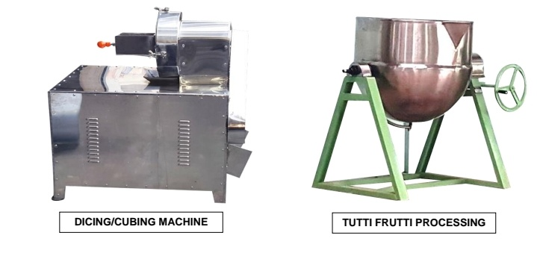
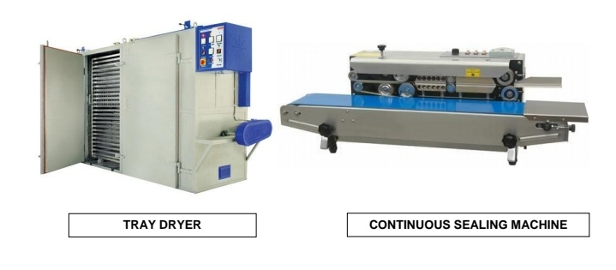
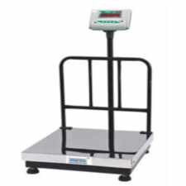
MACHINARY
Cubing Machine (Price-3.33L)
Tray Drier(Price-2L)
Mixing machine(Price-2.26L)
Sealing machine(Price-30,000)
Weighing Machine(Price-20,000)

Slide 13
PROJEECT AT A GLANCE
TUTIFRUTI MANUFACTURING FLOWCHART
Collect green papaya
Washing
(Portable water)
Peeling
Slicing & deseeding
Added sugar syrup
Blanched papaya
Blanching
(5min/ 40-70˚ C)
Chopping
Sugar(60˚ Brix)
Citric acid(0.2%)
Flavor
Drainage extra sugar
Added colour
Drying(70˚C/30 min)
Packing
Dispatch
Lab Test( Moisture test)
13

Slide 14
PLANT LAYOUT
E
ROAD
N
S
W
Locker room
==
Temple
Security room
Washroom
Garden
Toilet
Office
Dock side
Rest room
1
Packaging material
Receiving area
7
8
9
10
Processing section
11
6
13
Storage room 2
Power supply
Wash room
12
Packaging section
Raw material store room
3
5
Lab
Storage room1
2
4
Dock side
Parking
Weight machine
Weight machin
Washing area
Peeler
5. Table
6. Cubing Machine
7. Blanching
8. Screen
9. Sugar solution preparation
10. Screening
11. Adding color
12. Tray drier
13. Packaging machine
Pump
Boiler
ETP

Slide 15
LAB TEST
Tutti Frutti Manufacturing Quality Specification:
Moisture test: The moisture content of the product at the time of packing should not exceed 6%(Moisture Test).
Microbiological test: Mold and fungal growth should be absent. It should also test negative for coliforms, salmonella, and streptococci.
Brix test: Sugar impurities test.

Slide 16
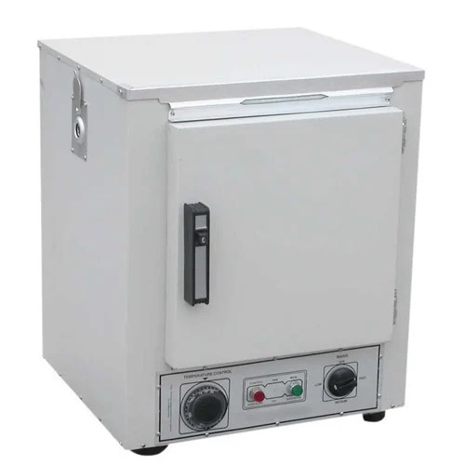
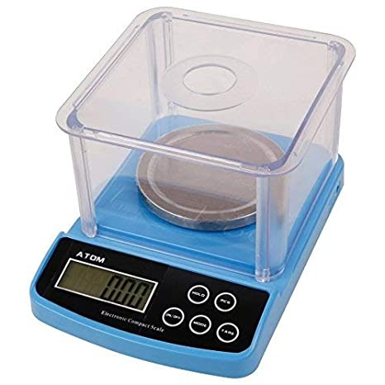
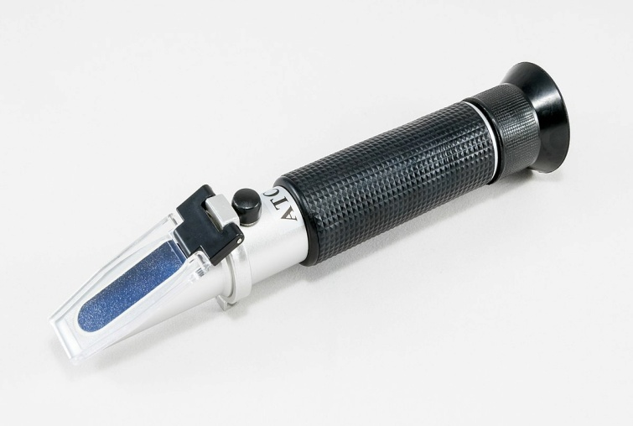
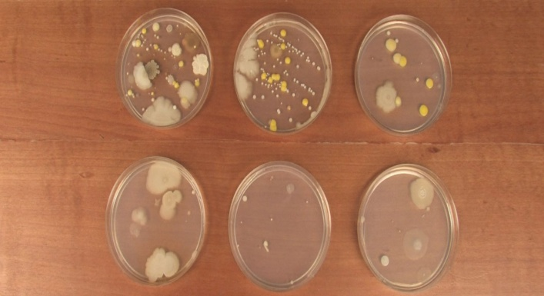
Weighing machine
(2,500/-)
Hot air oven
(35,000/-)
Refracto meter
(17,000/-)
Petri Dishes
(2000/-)

Slide 17
WASTE TREATMENT
The trutifruti industry typically generates organic waste such as fruit peels, seeds, and small portion of pulp, which can be treated using various methods.
COMPOSTING: Which involves breaking down organic waste through natural decomposition. This can be done on a large scale using specialized equipment or on a smaller scale using a simple compost pile.
ANAEROBIC DIGESTION: Which involves breaking down organic waste in the absence of oxygen. This process produces biogas, which can be used as a renewable energy source. Anaerobic digestion can be done using specialized equipment, such as a biogas plant.
In addition, the trutifruti industry can also utilize wastewater treatment processes to treat any water contaminated by the waste generated during the production process. This can be done using physical, chemical, or biological processes, depending on the type and degree of contamination.

Slide 18
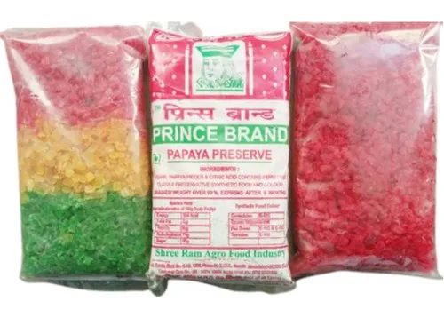
Product Pricing
100g
(15/-)
300g
(40/-)
500g
(65/-)
1kg
(120/-)
5kg
(500/-)
Weight | Production Cost | Per (%) | Selling price | Price limit(MRP) | Production amount | Total profit
100g | 4.5/- | 100% | 9/- | 15/- | 100kg | 9000/-
300g | 13.5/- | 90% | 25.65/- | 40/- | 100kg | 8567/-
500g | 22.5/- | 80% | 40.5/- | 65/- | 200kg | 8100/-
1kg | 45/- | 60% | 72/- | 120/- | 400kg | 28800/-
5kg | 225/- | 50% | 337.50/- | 500/- | 200kg | 13500/-
One day Profit=(67967-45000)=22967/-

Slide 19
MARKET STRETEGY
Discount offer
Advertising
Retailer
Shop
Pricing
Branding
Tagline
Target market:
1.Wholesaler
2.Digital marketing
3.Cake & Chocolate industry
4.Shops
5.Shopping Complex

Slide 20
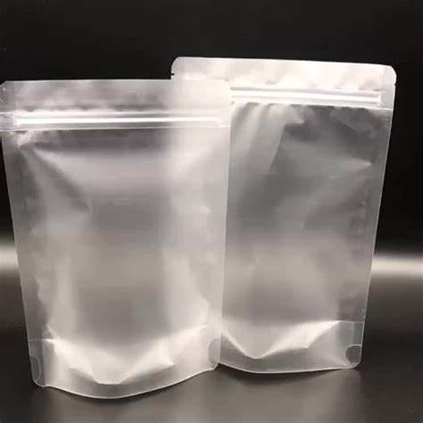
Packaging Requirements
Packaging helps market the product as well. Manufacturers know that candy must be hygienic and attractive to customers. In the children's market quantity, novelty, large size and bright colors are the top sellers. Many companies redesign the packaging to maintain consumer appeal.
Characteristic of Packaging:
Moisture Barrier
Fat Barrier
Resistance To Breakage
Flavor Retention
Ease Of Opening and (Sometimes) Ease Of Reclosing
Ability To Be Decorated For Visual Attractiveness
Protection For Prolonged Periods
Packaging: The candied Papaya (Tuti-fruti) can be packed in pouches of 100gm, 300gm, 500g, 1 kg and 5Kg packaging
Mainly Polypropaylene film are use because its transparency,moisture and fat barrier, and eventual heat sealability for pouches.

Slide 21

PRODUCT DETAILS
Brand name- Rainbow queen
Product name- Trutifruti
Tagline- Choice in Taste , Rainbow Queen is Best

Slide 22
THANK YOU

