Slide 1
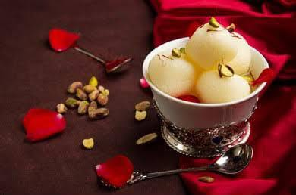
PROJECT ON ENTREPRENEURSHIP
DEVELOPMENT OF DIABETIC CANNED RASGULLA PLANT
Guide – APURBA GIRI¹ &
AYAN MONDAL²
HEAD OF ASSISTANT PROFESSOR¹
ASSISTANT PROFESSOR²
(DEPT. OF NUTRITION)
PROJECTED BY – AVISHIKTA DASH
Roll – 2206
Department of Nutrition,
B.Voc Food Processing 6th semester
Mugberia Gangadhar Mahavidylaya
Mugberia Gangadhar Mahavidylaya

Slide 2
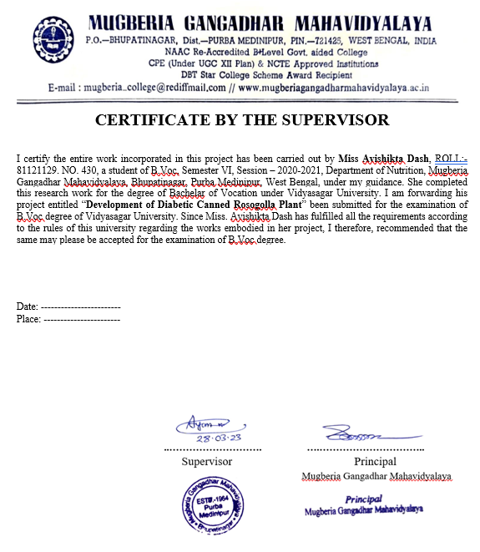

Slide 3
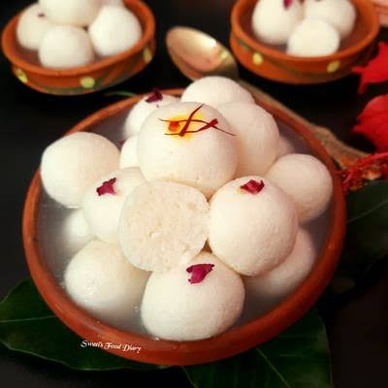
CONTENTS
INTRODUCTION
MARKET DEMAND
AREA
INVESTMENT
LISENCE
PRODUCTION
RAW MATERIALS
MACHINARY
FLOW CHART
LAYOUT
PACKAGING
MAN POWER
EQUIPMENTS DETAILS
SUPPLY
PRODUCT DETAILS
PRICE & QUANTITY
SHELF LIFE
MARKET STRATEGIES
SALARY
PROFIT

Slide 4
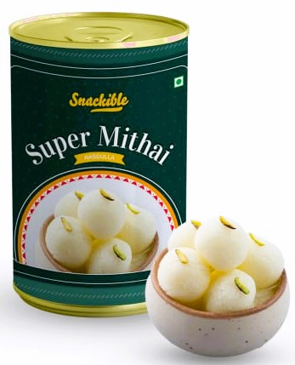
INTRODUCTION
Rasgulla or Roshogolla is an Indian syrupy sweet. The product is perishable. However, we can store canned rasgulla for a longer period. Here in this article, we intend to explore how to start a canned rasgulla making business.
Any individual can start a canned rasgulla making business with moderate capital investment. Additionally, revenue-wise the business is lucrative and highly profitable. However, you must ensure a regular supply of fresh milk to your factory.
In India, K. C. Das first started preparing canned rasgulla. And the product got the immediate popularity even abroad. Nowadays, you can find several brands of this item. This sweet item is popular throughout the country.

Slide 5
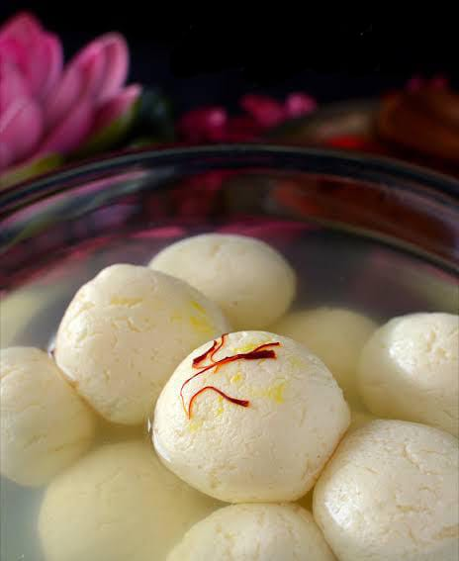
MARKET DEMAND
Rasgulla is very popular, especially in West Bengal, Bihar, Odisha, and North India. Its popularity is also growing up in South India. Canned rosogolla has more demand because it is more hygienically prepared and has a longer shelf life.
A major number of sweets shops do not produce items of their own. Generally, they outsource the item from reliable manufacturers. So you can sell fresh rasgulla to them. However, you must concentrate on the canned form. And this value-added item has more revenue potential compared to a fresh one.
It is seen that canned form makes transportation easier. And the product has good export potential. The major importing countries are Bangladesh, Nepal, Australia, Canada, the USA, Hong Kong, New Zealand, Malaysia, Singapore, etc.

Slide 6
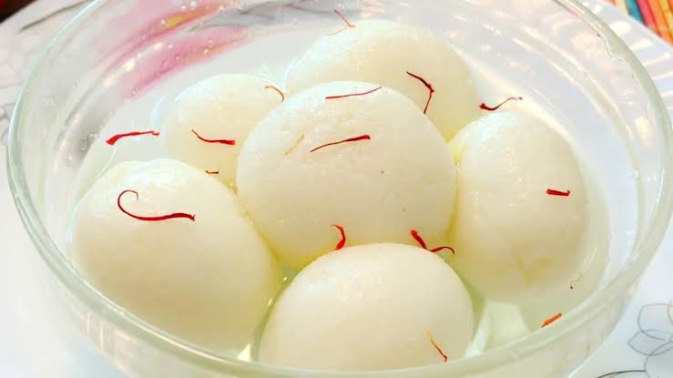
AREA & LOCATION
Land & Building – Area 1200-1500 sq. ft.
INVESTMENT
Total Capital Investment Rs. – 26 Lacks.
Land & Building Rs. – 8 Lacks.
Machinery Rs. – 9 Lacks.
Raw materials, labour cost and others Rs. – 9 Lacks.
REGISTRATION & LISENCE
In starting this business, you will need to apply for business registration and different licenses. Here we put some of the basic considerations. However, it is advisable to check your local state law.
First of all, decide on a form of organization and register your business with ROC.
Secondly, you must obtain a Trade License from the Municipal Authority.
Compliance with the PFA Act is mandatory. Apply for an FSSAI license as the business comes under the packaged food industry.
Apply for BIS Certification. Maintain quality standard specification IS 4079:1967.
Apply for GST registration number.
If you want to export the item, you must obtain an IEC license.
Additionally, you can protect your brand name by Trademark registration.
This business doesn’t attract pollution issues. However, check with your local PCB office.

Slide 7
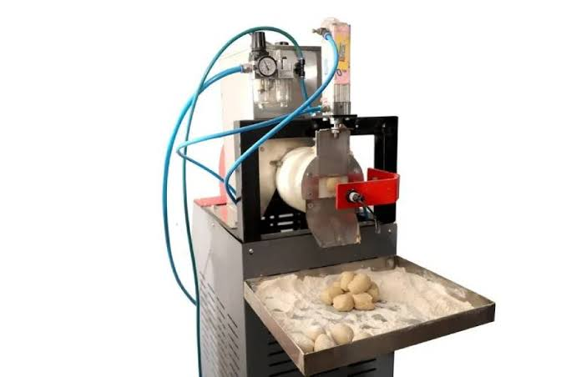
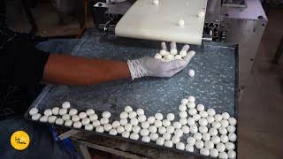
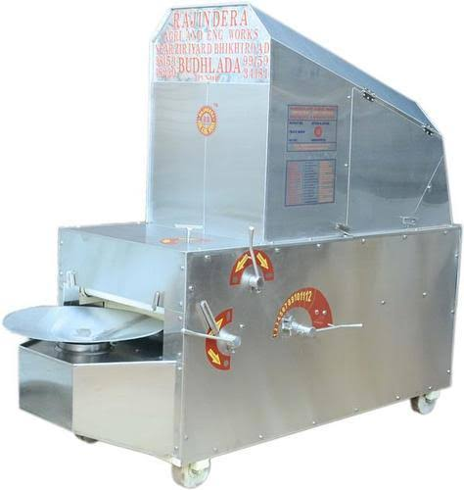
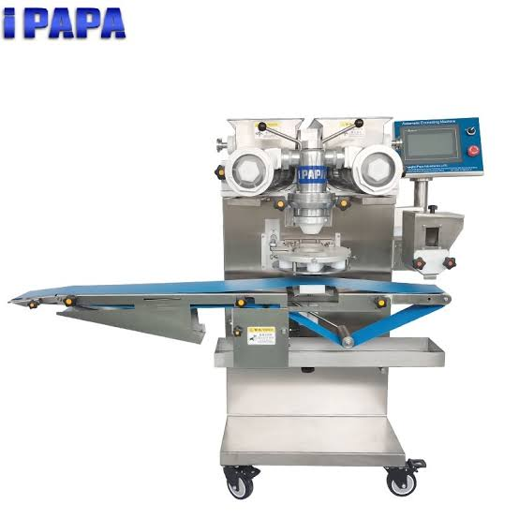
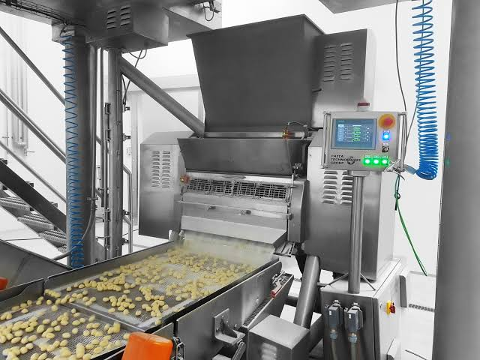
PRODUCTION
RAW MATERIALS
Skim milk (0.1% fat, 8.9% SNF & 0.17% acidity)
Citric acid
Sucralose
Sodium alginate
MACHINARY
Stainless Steel tank
Boiler
Milk weighing balance
Kneader
Automatic can sealer
Testing equipment
LAB TESTS
Fat test
Protein test
Quality test

Slide 8
EQUIPMENTS DETAILS
Serial No. | Equipments Name | Number | Cost
Production equipment's
01. | Stainless steel jacketed tank | 1 | 50,000
02. | Plate heat exchanger | 1 | 7,500
03. | Boiler | 1 | 15,500
04. | Milk weighing machine | 2 | 10,418
Quality control & testing equipment's
05. | Protein analyzer | 2 | 1,50,000
06. | Butyrometer | 2 | 160
Packaging equipment's
07. | Automatic can sealer machine | 1 | 63,299
Distribution equipment's
08. | Truck | 1 | 6,00,000
Total: |  |  | 8,96,877

Slide 9
FLOW CHART OF DIABETIC RASGULLA
Citric acid added
Cow milk
Heating to boiling point
FLOW CHART OF SOAKING SYRUP
Heating 80°c
Cooling/coagulation to 80°c
Boiling of water (100°c)
Holding coagulation mass for 10-15min
Strain
Whey
Added sodium alginate (1.67%)
Dripping of whey(30-45min)
Added of sucralose (18%)(20-30 min boiling)
Channa
Preparation of soaking syrup(16%)
Kneading and ball formation
Cooking in sucralose solution (18%) for 20-30 min soaking in 16% sucralose solution
Sucralose sweet syrup cheese ball formation(Rasgulla)

Slide 11
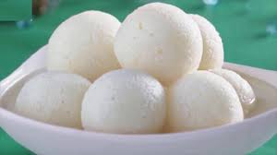
PACKAGING
Metals such as steel and aluminum are used in cans and trays. It also is used in trays and for wraps such as aluminum foil, which provide an oxygen and light barrier. It is lighter in weight than steel and resists corrosion.
MAN POWER
12 Labours(11 Ladies & 01 gents)
4 Labours (Processing section)
2 Labours (Packaging section)
2 Ladies (Lab)
2 Labours(Store section)
1 Ladies & 1 Gents(security guard)
SUPPLY
Online
Offline

Slide 12
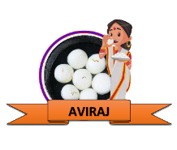
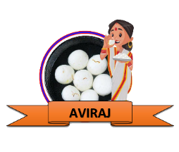
PRODUCTS DETAILS
Objective | 500 gm | 700 gm | 1 kg
Raw materials | 50 | 110 | 150
Can | 25 | 40 | 45
Labels | 12 | 25 | 30
Water | 13 | 22 | 25
Electricity | 15 | 20 | 23
Labour | 20 | 50 | 90
Cartoons | 15 | 20 | 25
Others | 20 | 23 | 12
PRICE & QUANTITY
500gm(pieces: 10)
700gm(pieces: 15)
1kg(pieces: 20)
Size of cans | Total cost | Wholesaler cost | MRP | Profit
500gm | 170 | 200 | 250 | 30
700gm | 310 | 350 | 400 | 40
1kg | 400 | 450 | 500 | 50
SHELF LIFE
Best before 6 months from date of packaging.
After opening refrigerate and consume within 1-2 days

Slide 13
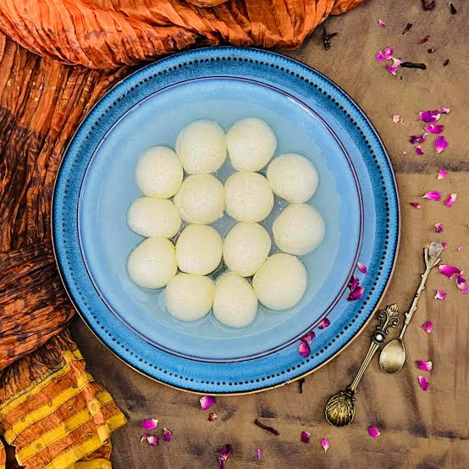
MARKET STRATEGIES
Digital marketing
Advertising
Direct marketing
Restaurants
Shopping complex
Social media(like- flipkart, amazon, big basket, food mart etc.)
SALARY
Salary per worker – 8k
Lab assistand – 10k
PROFIT
Depending on production

Slide 14
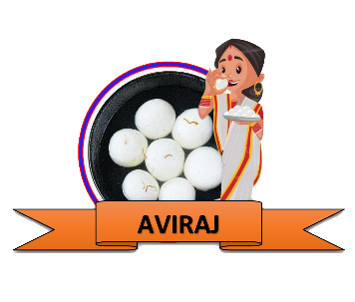
HOW TO DO BRANDING FOR MY DIABETIC CANNED RASGULLA PRODUCT?
Register an easy and catchy name to remember the name for product branding. Add product brand name, product description, logo, content, net weight and preparation ingredients on the can.
Name Of The Plant
AVIRAJ CANNED SWEETS
“I AM SO SWEET, BUT NOT HARMFUL TO YOU”

