Slide 1
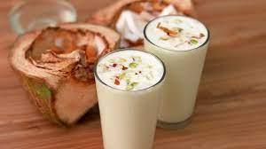
Project on entrepreneurship DEVELOPMENT OF LASSI PLANT Henria : Purba Medinipur: west Bengal: pin-721430
PROJECTED BY:
Rakhi jana
B. Voc (Food Processing, 6th sem)
Dept .of Nutrition
Mugberia Gangadhar Mahavidyalaya
GUIDED BY:
DR.APURBA GIRI (Assistant Professor and HOD)
AYAN MANDAL (Assistant Professor)
Dept .of Nutrition
Mugberia Gangadhar Mahavidyalaya

Slide 2
.

Slide 3
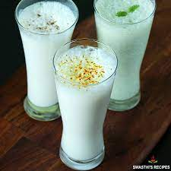
INTRODUCTION:
A business (also known as an enterprise, a company or a firm) is an organizational entity involved in the provision of goods and services to consumers.
Businesses as a form of economic activity are prevalent in capitalist economies, where most of them are privately own and provide goods and services to customers in exchange for other goods, services, or money.
Businesses may also be social non-profit enterprises or state-owned public enterprises charged by governments with specific social and economic objectives.

Slide 4
WHY I OPTED THIS TOPIC:
Franchising Lassi shop is very profitable as the owners can get around a 60% margin on the sale of the beverages.
A Lassi shop in India is like a common spot for people of all ages to gather, grab a glass of lassi, and talk.

Slide 5
MARKET SURVEY:
Market survey is the survey research and analysis of the market for a particular product/service which includes the investigation into customer inclinations.
A study of various customer capabilities such as investment attributes and buying potential.
Market surveys are tools to directly collect feedback from the target audience to understand their characteristics, expectations, and requirements.
Market surveys collect data about a target market such as pricing trends, customer requirements, competitor analysis, and other such details.

Slide 6
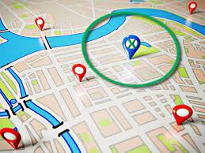
LOCATION CHOOSE:
Look for areas where your product or service is in high demand or where your competition is fairly low.
If at all possible, you'll want to expand to a location where the other businesses on the block are complementary, to ensure your business fits into the local market.

Slide 7
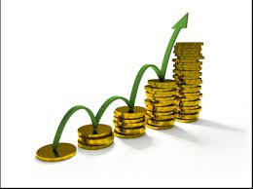
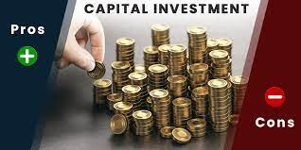
INVESTMENT:
CAPITAL 10-15 LAKHS
Manpower - 20-25
.

Slide 8
LICENCE:
Business Entity
FSSAI registration
Trade License
Udyog Aadhaar Registration
GST Registration
BIS certification
No Objection Certificate From State Pollution Control Board

Slide 9
LAYOUT:

Slide 10
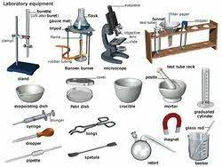
EQUIPMENT:
Milk storage tank
Motor
Packaging machine
Gerber centrifuge
Lactometer
Thermometer
Refrigerator
Weight machine
Water bath
Hot air oven

Slide 11
FLOW CHART:
Milk
Freeze dried culture1.5%
Lassi
.
Incubation 6hrs
0.9% Flavour
Curd(FAT-3.0/SNF-12.5)%
Cooling(7-8⁰c)
45% water, 12% sugar
Preheating(65⁰c)

Slide 12
LAB TEST:
FAT TEST
CLR TEST
SNF TEST
ACIDITY TEST
ALCOHOL TEST
MBRT TEST
POUCH QUALITY TEST

Slide 13
MARKET STRATEGY:
Publicity
Advertising
Sales promotion
Direct marketing
Special discount

Slide 14
TARGET COUSTOMER BEING:
Sweets shops
Hotels and restaurants
Marriage and functions
Wholesalers

Slide 15
CONCLUSION:
A business plan conclusion, doesn't need to be very long, in fact, it can be pretty brief.
Your conclusion should; reiterate the opportunity, highlight the key strengths of your plan, summaries your vision, and remind the reader why your business is in a position to successfully execute the plan.

Slide 16
Thank you
.

