Slide 1
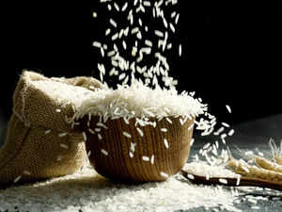
Project on entrepreneurship
DEVELOPment of RICE INDUSTRY
PROJECTED BY-
Pritam Ghosh
B.VOC (Food processing 6th sem)
Roll-2218
DEPARTMENT OF NUTRITION
MUGBERIA GANGADHAR MAHAVIDYALAYA
GUIDED BY-
Dr. Apurba Giri ( Head of assistant professor)
Ayan Mondal (Assistant professor)
MUGBERIA GANGADHAR MAHAVIDYALAYA

Slide 2
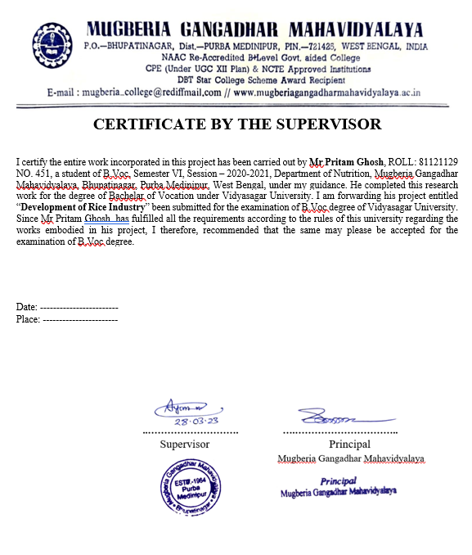
.

Slide 3
CONTENTS
Why i open a rice industry
Machinery name,cost
Manufacturing process
Packaging
Production and making cost
Investment, profit, Manpower
Select industry land location
Licences
Targeted customers
Market Strategies

Slide 4
1.Production 2.Demand 3.Customer attraction 4. Profit 5. Location 6. Electricity supply
WHY I OPEN A RICE INDUSTRY

Slide 5
MACHINE NAME AND COST
Paddy cleaner | 1,80,000
Destoner | 90,000
Rice husker | 1,13,000
Rice polisher | 1,64,000
Rice grader | 60,000
Rice whitener | 1,93,000
Paddy separator | 87,000
Length grader | 70,000
Color sorter | 1,43000
Thickness grader | 1,79000
Packaging machine | 45,000

Slide 6
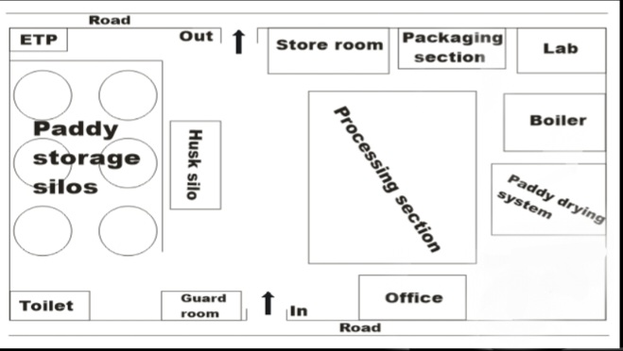

Slide 7
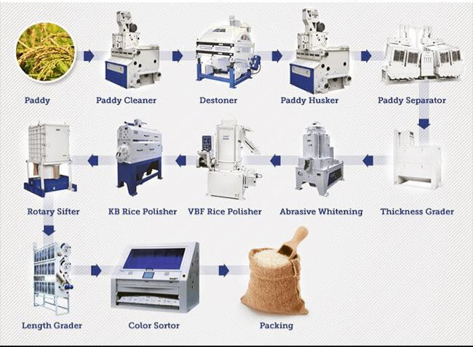
MANUFACTURING PROCESS OF PADDY

Slide 8
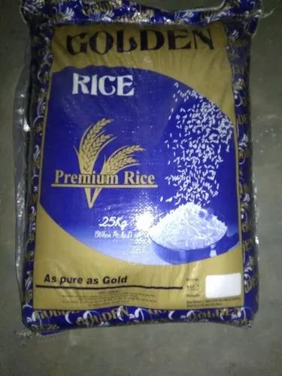
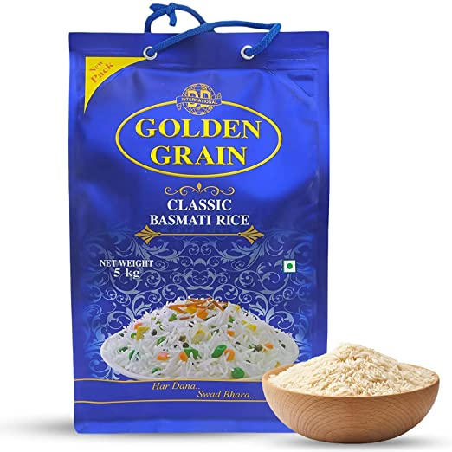
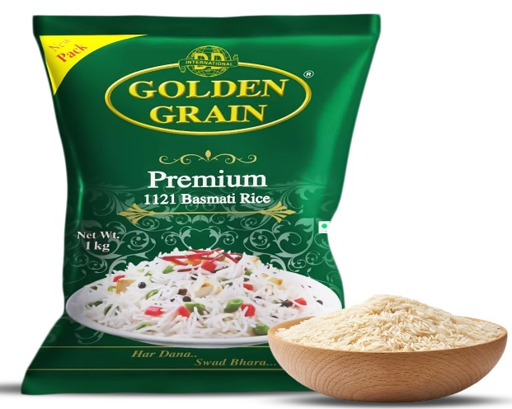
PACKAGING
1Kg GOLDEN RICE = 90
5KG GOLDEN RICE = 450
26KG GOLDEN RICE = 2200

Slide 9
Making cost
Production per day -
20matric tone(200 kuintal)
Per day Labour cost= 3000
Per day electricity cost= 2000
Packaging cost= 20000
Total making cost= 25000
1kg | 5kg | 26kg
Rice making cost= 31.50 | Rice making cost= 151.50 | Rice making cost= 780.50
Retailers cost= 33 | Retailers cost= 154 | Retailers cost= 783.70
Market price =34.50-35 | Market price= 155.50 | Market price= 784.50- 785

Slide 10
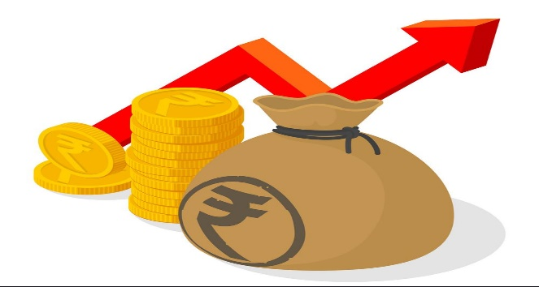
INVESTMENT
CAPITAL :- 2crore
PROFIT –
Depends also production ,
Product quality,
Buisness model
Manpower-
processing section- 3,boiler- 1, marketing-3, lab- 1, packaging-1,

Slide 11
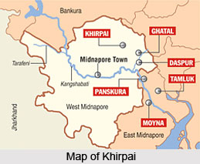
SELECTION OF PLANT LAND LOCATION
Establishing a workable rice industry seeks a minimum 40,000- 43,200SQ FT. The layout of the same should be tweaked in accordance with the equipment to be used in the process to maximize efficacy. If possible, select the location that comes in close proximity to the marketing distribution areas. This way, it will become easier to reduce the overall transportation cost.

Slide 12
LICENcES
Factory licences
Firm registration
FSSI Certificate
PFA and ESIC Registration
GST registration
No objection certificate from pollution department

Slide 13
TARGETED CUSTOMERS
Retailers
Online
Super market /sopping hole
Hotel / restaurant
Paddy mill
Others

Slide 14
MARKET STRATEGY
SPECIAL DISCOUNT %
DIRECT MARKETING
ADVERTISING
PUBLICITY

