Slide 1
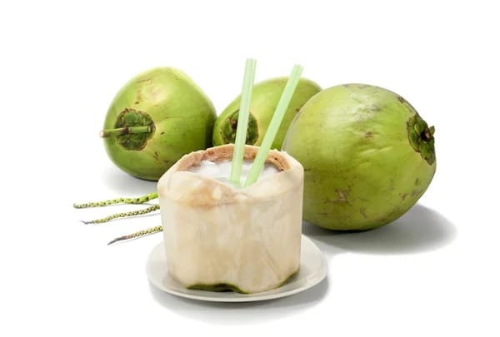

PROJECT ON ENTERPRENEURSHIP
DEVLOPMENT OF COCONUT JELLY PLANT
GUIDE BY:
DR. APURBA GIRI¹,
AYAN MONDAL² ,
(Head of Nutrition department ¹ ),
(Assistant professor² )
PROJECTED BY:
JEET SENAPATI,
(Student of B.Voc
Food Processing, 6th sem
Dept. of Nutrition)
MUGBERIA GANGADHAR MAHAVIDYALAYA
MUGBERIA GANGADHAR MAHAVIDYALAYA

Slide 2
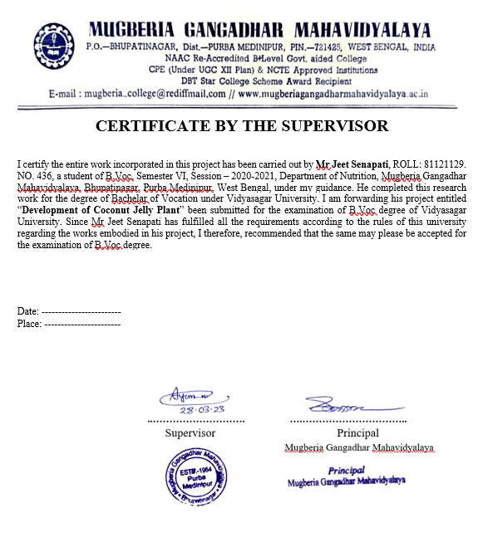
.

Slide 3
Outline of my project
About my product
Scope of coconut jelly
Market survey
Marketing strategies
Certificates
Product flow chart
Plant layout
Lab test
Lab test machinery
Area , Capacity & Location
Machinery
Total investment
Man power
One day raw material requirement
Production cost
Product pricing
Packaging requirement

Slide 4
About my product
Coconut jelly mainly produced coconut water, with cream or without cream. (Cream means soft coconut).
Fresh and natural product.
Some environment friendly packaging.
Meditational benefits.
Rare in market.
Attractive for children's.

Slide 5
SCOPE OF COCONUT JELLY
Coconut jelly is made by coconut water with flavor & taste. It provides attractiveness as well as nutritive value to many food items. Also it have many medicinal benefits.
Beaches and coastal areas: Coconut trees are often found near the coast, so it's common to find vendors selling fresh coconut water and jelly on beaches.
Tropical markets: In some tropical countries, markets and street vendors.
Food festivals and fairs: Coconut water and jelly are popular refreshments at many food festivals and fairs, especially those with a tropical theme.
Smoothie and juice bars: Some smoothie and juice bars offer coconut water and jelly as a healthy and refreshing beverage option.
Health food stores: Many health food stores carry fresh coconuts and coconut jelly, which you can enjoy at home or on the go.
Online stores: Amazon fresh, Nature’s basket, Farmers Fresh Zone, etc.

Slide 6
market survey
Target audience: Identify my target audience and gather information about their preferences, dietary restrictions, and eating habits.
Competitors: I can Research my competitors and understand what they offer, how they market themselves, and how i can differentiate my business.
Menu development: Create a menu that aligns with my target audience's preferences, dietary needs, and budget.
Pricing: Determine the price point at which my target audience is willing to pay for my food products or services.
Location: Identify potential locations for my business and evaluate the demographics, foot traffic, and competition in each area.
Suppliers: Identify and evaluate potential suppliers for my ingredients, packaging, and other supplies.
Marketing: Develop a marketing plan to promote my business, including strategies for social media, advertising, and word-of-mouth referrals.
Regulations: Understand the food safety regulations and licensing requirements in my area and ensure that my business complies with them.

Slide 7
Market strategy
Branding
Positioning
Channels
Pricing
Promotion
Partnerships
Customer engagement

Slide 8
CERTIFICATS
Food products order licenses (FPO)
NOC paper (form state pollution control)
Trade license
GST
FSSAI Licenses
Registration for trademark
Fire Registration
BIS Certificate
ISO 14075, ISO22000

Slide 9
PRODUCT FLOW CHART
Peeling
+
Cutting
Scrubbing the head portion
Washing with hot water(50˚C/30Sec)
Receiving green coconut
Cleaning with chlorinated water (100ppm)
Adding sugar
(test wise)
Strain
the coconut water
Receiving the Coconut water
Cutting
the head portion
Filtration
Adding agar agar powder(1-2%)
Adding preservative (1.5%)(Sodium benzoate)
Heating
(85-90˚C/ 10-15 min)
Coconut shell
Washing
Filling in coconut
shell
cooling in 25˚C for 5-10 min
Shorting(Size wise)
Adding citric acid
(0.2%)
Immediately cooling
50˚C
Checking and cream removing
Washing potable water
Packaging
Jelly formation(set room)(room temperature/ 2-3h)
Store
(<5˚C)
Store in packaging section
(Shelf life – 15days, below 5˚C)

Slide 10
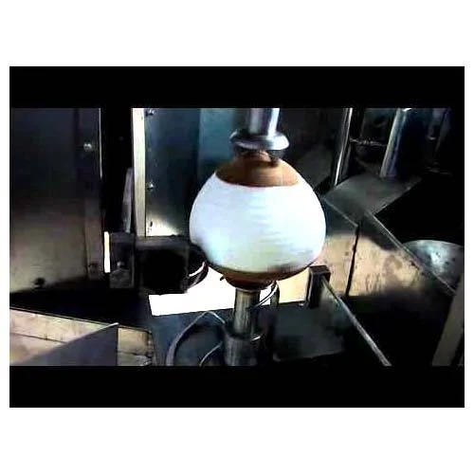
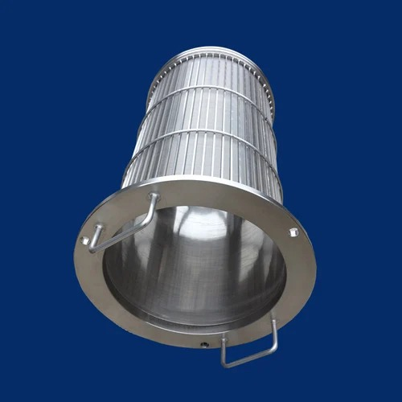
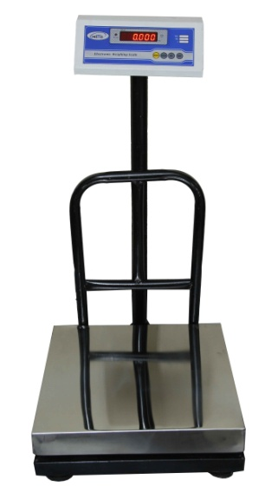
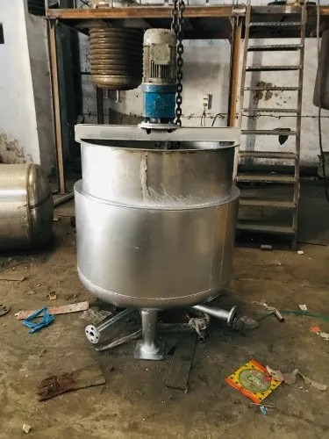
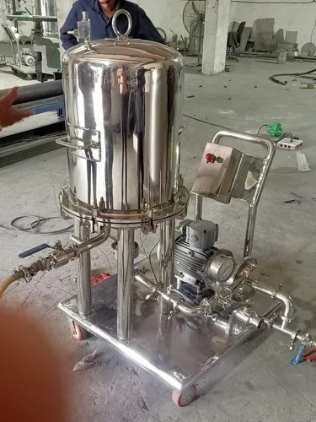
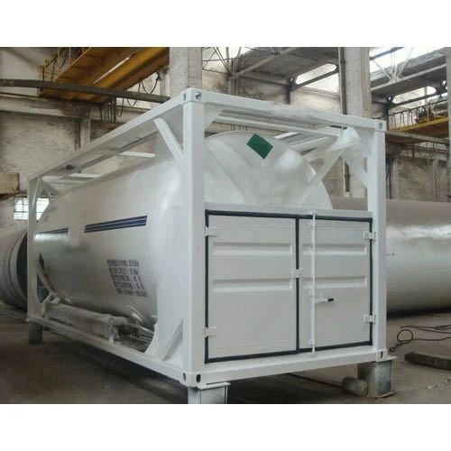
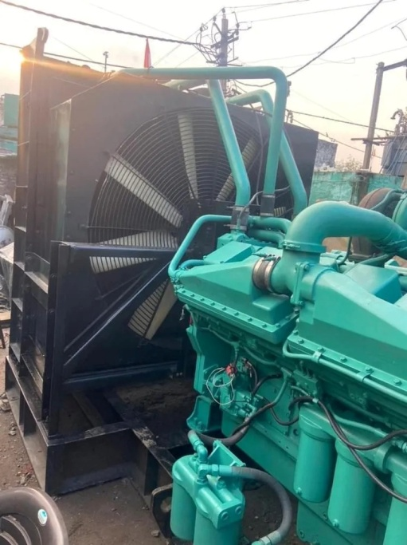
MACHINARY
Peeler (2p)
(4.25 L)
Strainer(1p)
(20,000/-)
Weighing machine (2p)
(10,000/-)
Mixing (2p)
(25,000/-)
Filter (1.75 L)
Storage tank (3 L)
D.G. (2p)(2 L)

Slide 11
Plant layout
R
O
A
D
Exit
Entry
Locker room
Office
Toilet
Security
Security
Gardening
Parking
Rest
room
Storage room 1
Receiving
Toilet
D O C K S I D E
Storage room 2
Set room
Raw material store
Packaging
Processing
Parking
Store
Room
Storage room 3
Lab
D O C K S I D E
D. G.
ETP
Pump
Boiler
IBT

Slide 12
LAB TEST
Moisture content: This test determines the amount of moisture present in the coconut jelly. It is important to maintain a specific moisture content to ensure the quality and shelf-life of the product.
pH level: pH level testing is done to ensure that the coconut jelly has the correct acidity level. This is important for both taste and safety reasons.
Total soluble solids (TSS): TSS is a measure of the concentration of all soluble substances in the coconut jelly, including sugar and other components. This test is important to ensure consistent product quality and sweetness.
.
Microbiological testing: This involves testing for the presence of microorganisms such as bacteria and yeast. This test is essential to ensure that the coconut jelly is safe for consumption.
Chemical analysis: This includes testing for the presence of contaminants such as heavy metals, pesticides, and other harmful substances.
Texture analysis: This test is done to evaluate the texture of the coconut jelly, including its firmness, cohesiveness, and springiness.

Slide 13
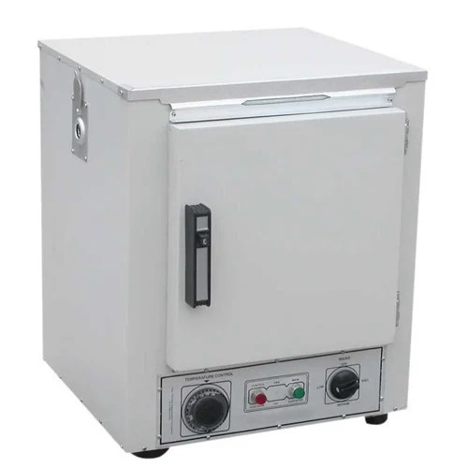
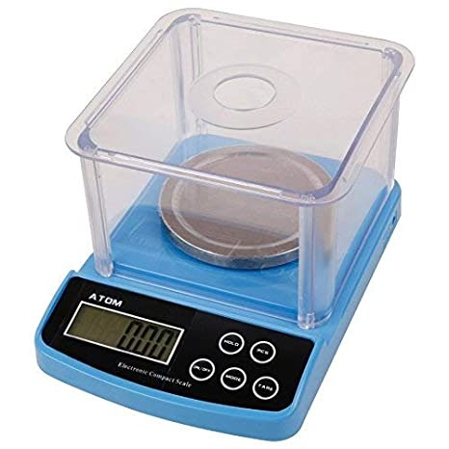
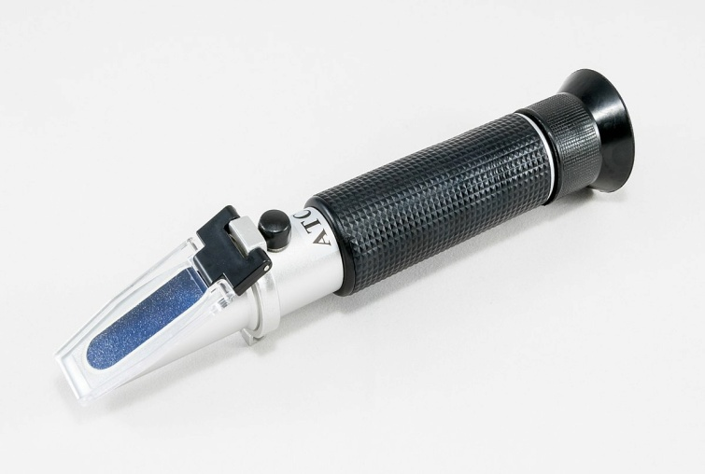
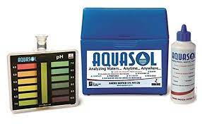
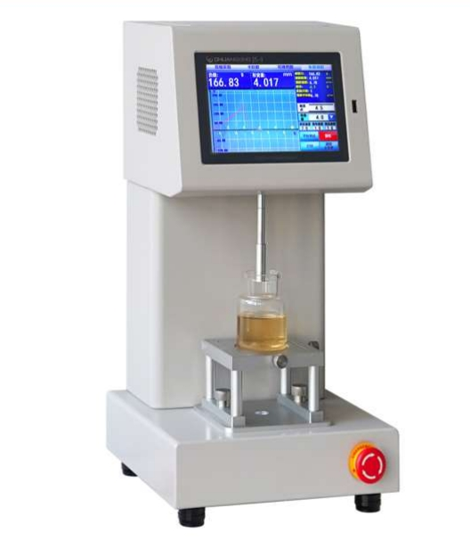
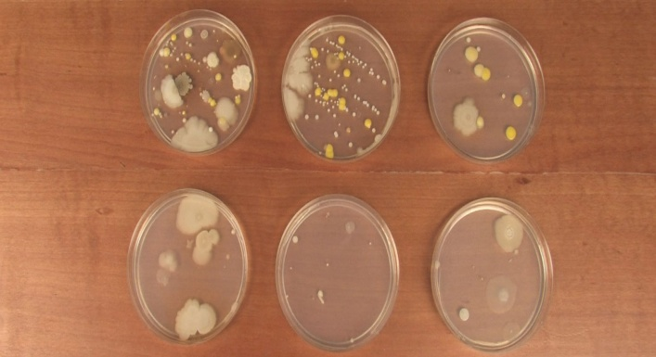
LAB TEST MACHINERY
Weighing machine
(2,500/-)
Hot air oven
(35,000/-)
Refracto meter
(17,000/-)
Petri Dishes
(2000/-)
PH testing kit
(650/-)
Texture Analyzer
(75,000/-)

Slide 14

Area, capacity & location
A. Area:
The total area also requirement for the envisaged project is estimated at 20000-22000 square feet.
B. Capacity
Firstly, The establishment of a plant for the production of coconut jelly with a capacity of 2000-2500 pcs/ day.
C. Location
Bajkul to Contai

Slide 15
Firstly total investment
ITEMS |  | QUANTITY | TOTAL AMOUNT
LAND |  | 50D | 50 L(Lakh)
CAR |  | 2 | 9 L
BUILDINGS |  | ---- | 10L
M A C H I N E R Y | PEELER | 2 | 8.5L
 | SHAPER | 1 | 2L
 | CUTTER | 1 | 1.5L
 | MIXER | 2 | 0.5L
 | FILTER | 1 | 1.75L
 | STAINER | 1 | 0.20L
 | WEIGHING | 3 | 0.17L
 | STORAGE TANK | 1 | 3L
 | D.G. | 2 | 4L
TOTAL = |  |  | 90.67L≈100L

Slide 16
Manpower (Salary/Month):
Security guard(2) | Rs. | 14000.00
Receiving + R store(1) | Rs. | 10000.00
Helper(3) | Rs. | 21000.00
L ab assistant(1) | Rs. | 10000.00
Processing(3) | Rs. | 27000.00
Shift incharge (1) | Rs. | 13000.00
Packaging(2) | Rs. | 18000.00
Set room(1) | Rs. | 9000.00
Storage(1) | Rs. | 9000.00
Market sector(2) | Rs. | 24000.00
Electrician(1) | Rs. | 10000.00
Boiler + IBT + ETP (2) | Rs. | 16000.00
Car driver(2) | Rs. | 15000.00
TOTAL = | Rs. | 196000.00

Slide 17
One day raw material requirement with cost
The major raw materials required to produce Coconut jelly such as
RAW MATERIALS | PRICE /KG, L or PIC | TOTAL AMOUNT
Green Coconut | Rs. - 12/pic | 12*2100=25200/-
Agar agar(2%) | 300/kg | 5*300=1500/-
10% Citric acid(0.2%) | Rs. 50/kg | 50/2=25/-
Flavor (1%) | Rs. 295/L | 2.5*295=738/-
Preservative | Rs. 95/Kg | 3.75*95= 357/-
Sugar | Rs.30/kg | 25*30=750/-
Packaging | Rs. 0.25/pic | 500/-
Water | Rs.300(1day) | 300/-
Fuel | Rs.500(1day) | 500/-
Cleaning agent | Rs.300(1day) | 300/-
 | Total= | Rs.30,170/-

Slide 18
Production Cost /Day:
Items |  | Price
Transportation | Rs. | 2000.00
Lab | Rs. | 200.00
Electricity | Rs. | 1500.00
Raw material | Rs. | 30170.00
Man power | Rs. | 6535.00
Loan(7year plan)(50%) | Rs. | 3053.00
Total= | Rs. | 43458/- ≈ (44K-45K)
1 Coconut contain ≈ 120ml.
2100 Coconut contain ≈ 250 lit.
∴ 1g coconut jelly price = 0.18 rupees.

Slide 19
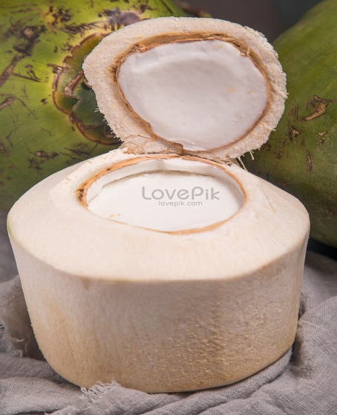


PRODUCT PRICING
75g
(30/-)
150g
(48/-)
200g
(65/-)
Weight | Production Cost/ ml | Per (%) of profit | Selling price | Price limit (MRP) | Production amount (pcs) | Total sealing price
75ml | 13.5/- | 77% | 24/- | 30/- | 1000 | 24000/-
150ml | 27/- | 50% | 40/- | 48/- | 500 | 20000/-
200ml | 36/- | 44% | 52/- | 65/- | 500 | 26000/-
One day Profit= (70,000-45,000)=25,000/-

Slide 20
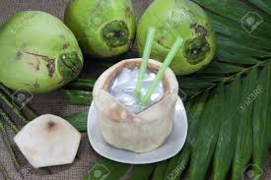
PACKAGING REQUIREMENTS
Packaging helps market the product as well. Manufacturers know that jelly must be hygienic and attractive to customers. In the children's market quantity, novelty, large size and bright colors are the top sellers. Many companies redesign the packaging to maintain consumer appeal.
Characteristic of Packaging:
Moisture barrier.
Fat barrier.
Resistance to breakage.
Transparency.
Ease of opening and (sometimes) .
Ability to be decorated for visual attractiveness.
Protection or prolonged periods.
Packaging: The coconut jelly can be packed in coconut shell of small(50-75g), medium(120-150g), large (150-200g) packaging.
Mainly Polypropaylene film are use because its transparency, moisture and fat barrier, and eventual heat sealabillity for wrapping.

Slide 21


Island jells
TM
FRIEND OF REFRESHMENT

Slide 22
Thank
you

Slide 23
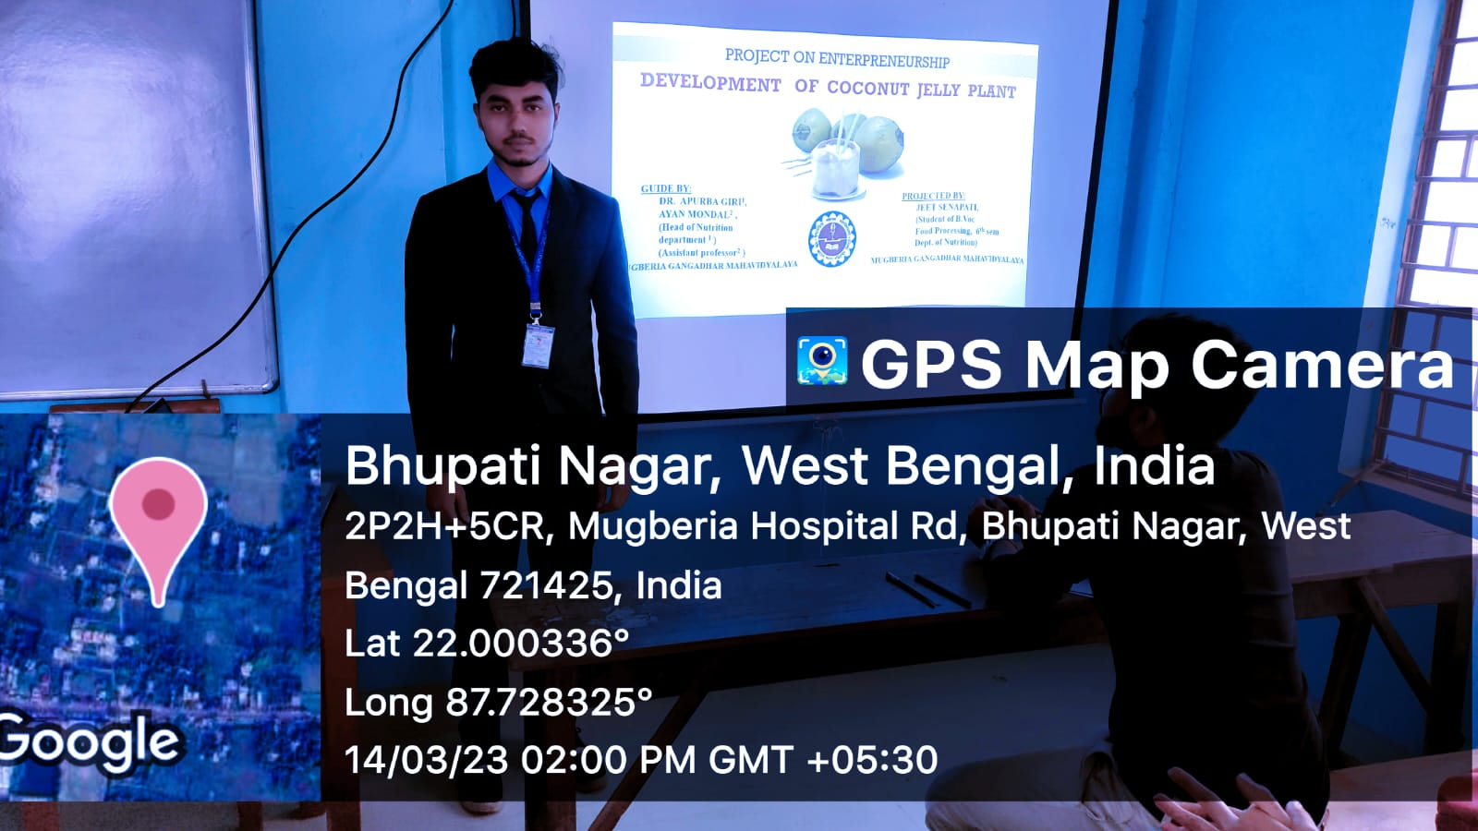
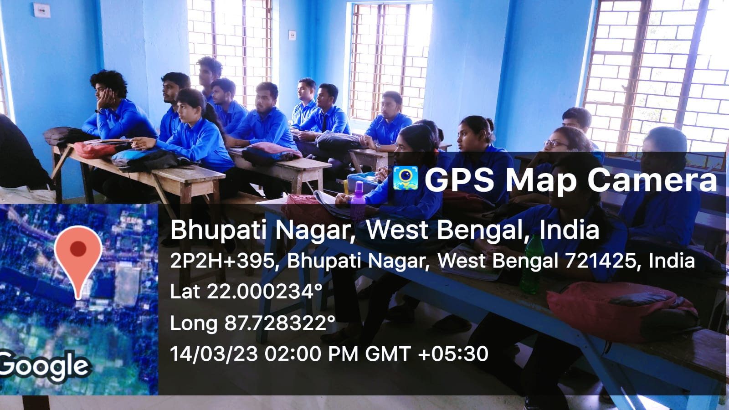
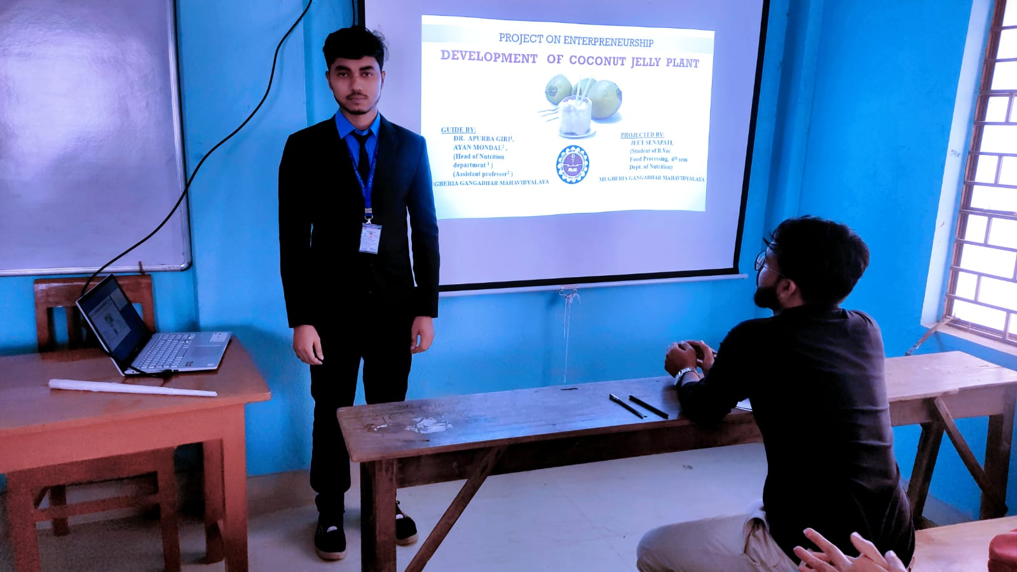
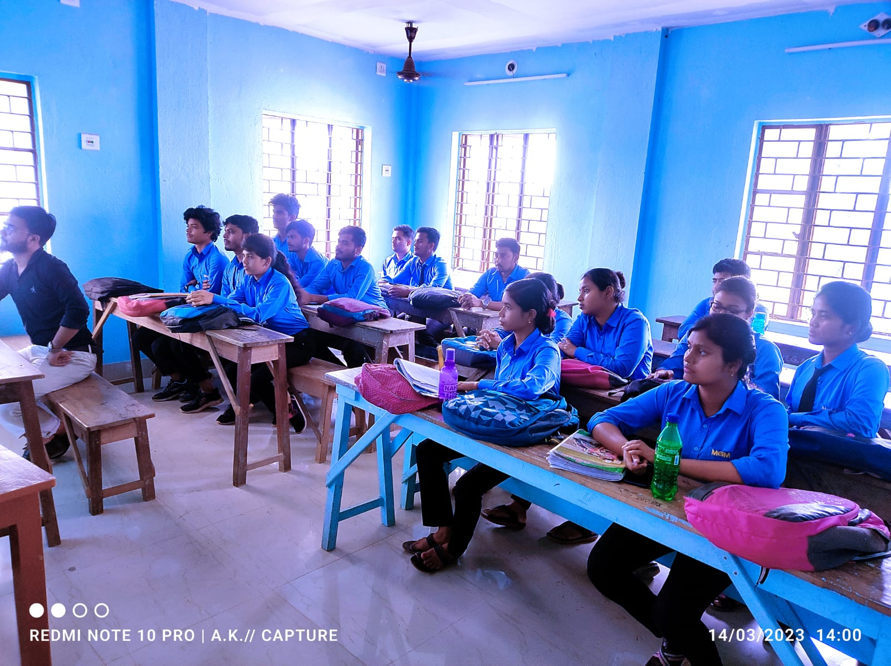

Slide 24
