Slide 1
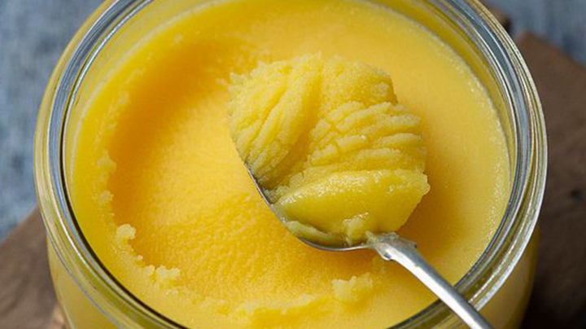
PROJECT ON ENTREPRENEURSHIP
DEVELOPMENT OF GHEE MANUFACTURING PLANT
GUIDED BY :
DR. APURBA GIRI (Assistant Professor and Head)
AYAN MONDAL(Assistant Professor)
Dept. of Nutrition
Mugberia Gangadhar Mahavidyalaya
PROJECTED BY:
PIU MONDAL
ROLL: 2216
B.Voc (Food Processing, 6th Sem)
Dept. of Nutrition
Mugberia Gangadhar Mahavidyalaya

Slide 3
INTRODUCTION
Business is any economic activity that includes the purchase or sale of goods or services with the basic objective of earning profit and satisfying the individuals needs of the society
Business activities can be classified into two categories : Industrial and Commercial

Slide 4
WHY I START GHEE PRODUCTION PLANT
Ghee represents the second-largest consumed dairy product. More over demand is increasing quickly throughout the world.
The homemakers in the age group 25-45 having children who are the main consumer of ghee. So, it is a highly rewarding market for beginning an organized ghee manufacturing business.
It is not only popular for cuisine but it also has a wide range of uses in the medical field, cosmetics industries as well as in traditional religious.
Ghee is the richest source of animal fat for vegetarians. It provides 9k calorie energy/gm.

Slide 5
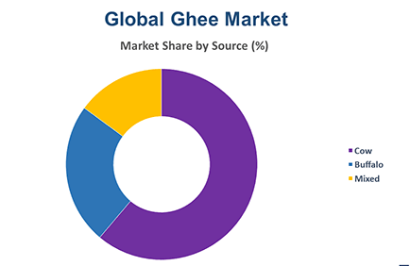
MARKET RESEARCH FOR GHEE MANUFACTURING PLANT
First of all, I should conduct thorough market research at my location. Mainly which types of ghee are available in the market
So, It is important to understand need to know the specific demand for various ghee varieties. Check the packing and price of those ghee packets
I need to do some market research to understand the behavior of the consumers in my area.
By creating the business plan I have the project cost, financial analysis, marketing plan, and summary of what steps to be taken.

Slide 6
KNOW THE BUSINESS
Demand
Supply
Price
Quantity
Quality

Slide 7
PLANT LOCATION
Raw material availability.
Location(with respect to the marketing area.)
Availability of labours
Transport facilities
Availability of water , electricity
Environmental impact and effluent
Local community considerations
AREA
25000- 27000 SQ.FT
INVESTMENT
25-30 LAKHS

Slide 8
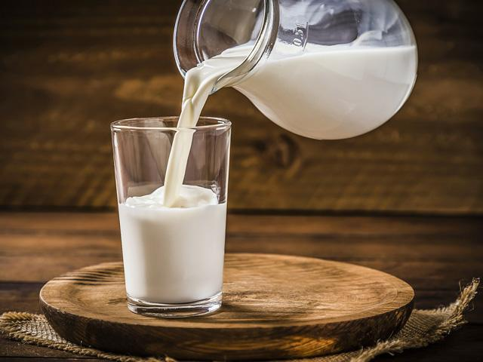
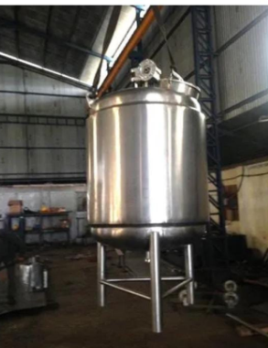
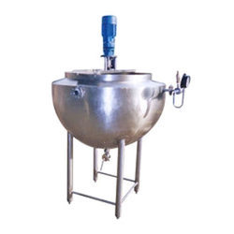
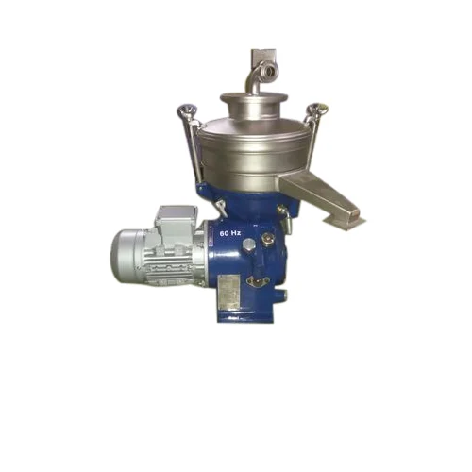
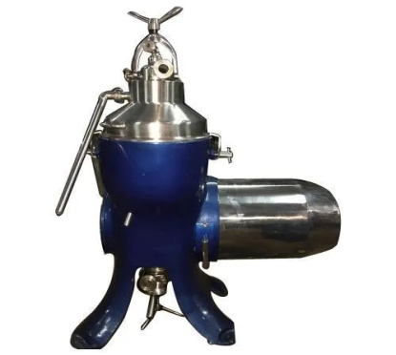
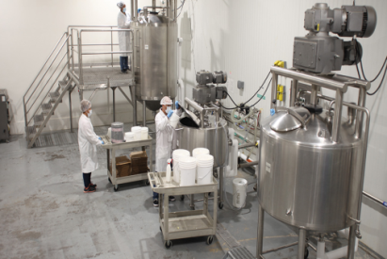
RAW MATERIALS
Milk
MACHINERY
Cream Separator
Double jacked kettle
Clarifier
Settling tank
Thermometer
Steam control valve
Others lab equipments

Slide 9
PROCESSING
Collection of cream in ss can
Dispatch
Storage
Ripening of cream f0r 4 to 5 days
Milk
Packaging
Cream
Transfer to packing room
Weighing of ripened cream
Cream Separator
Collection of ghee in ss can
Transfer to double jacked ghee kettle
Skim Milk
Clarified ghee transfer to settling tank
Heating at 129 to 130°C
with agitation
Clarification at 80°C
Manually scrapping the inner body of kettle
Filtration with muslin cloth

Slide 10
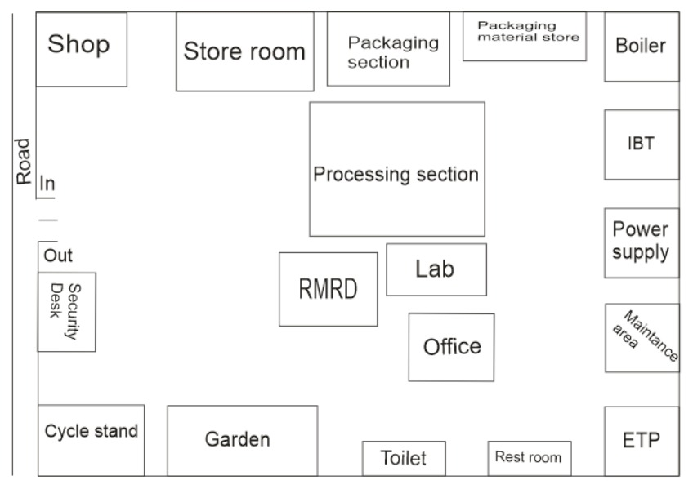

Slide 11
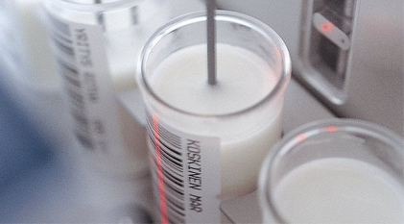
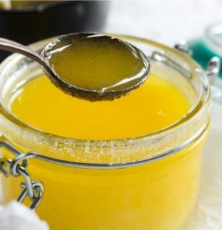
LABORTORY TEST
Fat
Acidity
SNF
Protein
COB
MBRT
Adulteration
CLR
Raw Milk :
Final product : i) Physical test – Colour ,Flavour , Texture
ii) BR test
iii) RM Value test
iv) Acidity
v) Moisture
vi) Free fatty acid

Slide 12
MANPOWER
Guard -2
RMRD section-2
Lab-3
Processing -2
Packaging -2
Shop store-1
Boiler -1
IBT- 1
Electrician-2
Marketing-1
Overall manegment-1

Slide 13
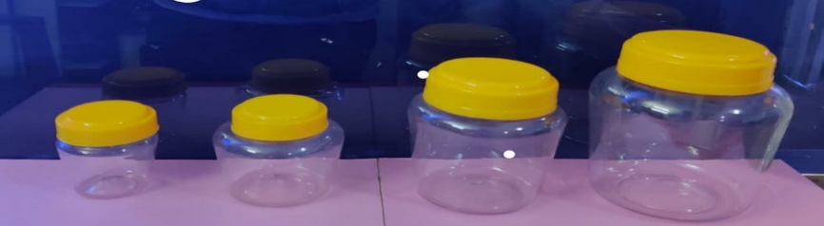
PACKGING AND PRICE
100gm
250gm
500gm
1kg
90/-
180/-
310/-
600/-
SHELF LIFE
6 months from the date of packging
SUPPLY
Offline
Online

Slide 14
TARGET CUSTOMERS
Wholesalers
Distributors
Stores
Supermarkets
Local shops
Restaurants
Hotels
Household

Slide 15
MARKETING STRATEGIES
Personal Selling
Advertising
Sales promotion
Direct marketing
Publicity

Slide 16
LICENSES
Register business
GST
Trade License
NOC
ESI Registration
FSSAI Registration
MSME Registration
Pollution Certificate
Trademark

Slide 17
PROFIT
For 1kg
Production cost - 560/-
Distributer price- 590/-
Market price - 600/-
Profit - 30/-
Depending on production and sell

