Slide 1

POPSICLE MANUFACTURING BUSINESS
PRESENTED BY:- Arabinda Bhunia B.Voc food processing, (Department of nutrition)
GUIDED BY:- Dr.Apurba Giri(HOD Department of nutrition)
MUGBERIA GANGADHAR MAHAVIDYALAYA
Bhupatinagar, Purbamedinipur,PIN:-721425

Slide 2
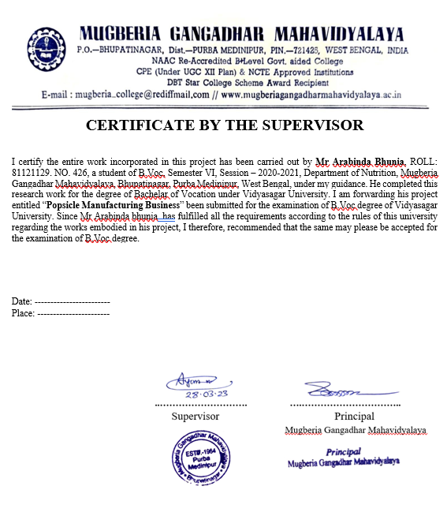

Slide 3
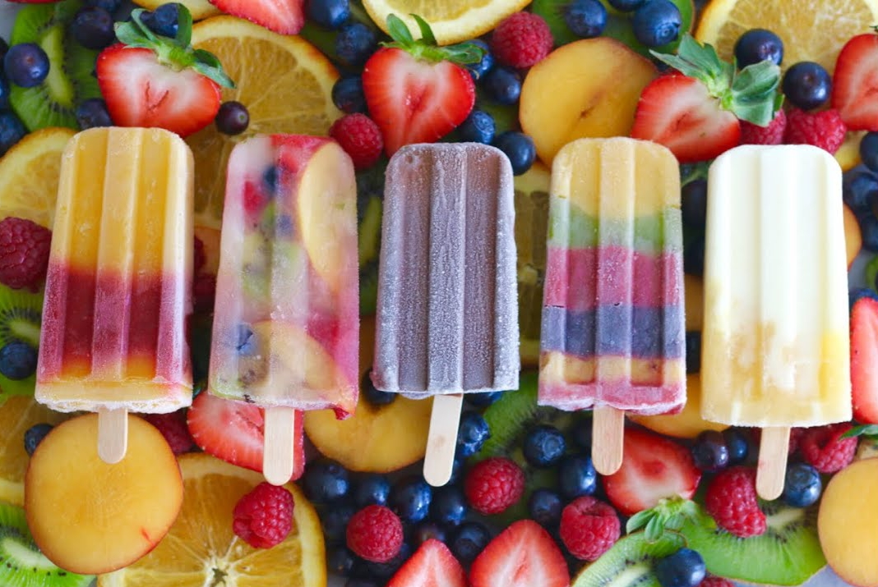
NUTRITIVE POPSICLE CENTER
Madhakhali, Bhupatinagar, Purbamedinipur
Contact Number:-8919863697/ 7363915247

Slide 4
What is popsicle?
Popsicles are the piece of flavoured ice or ice cream on a stick. Generally they are very chief in price that’s why they are very Popular in rural areas as well as urban areas. Most of us have it to get instant relief for burning summer.

Slide 5
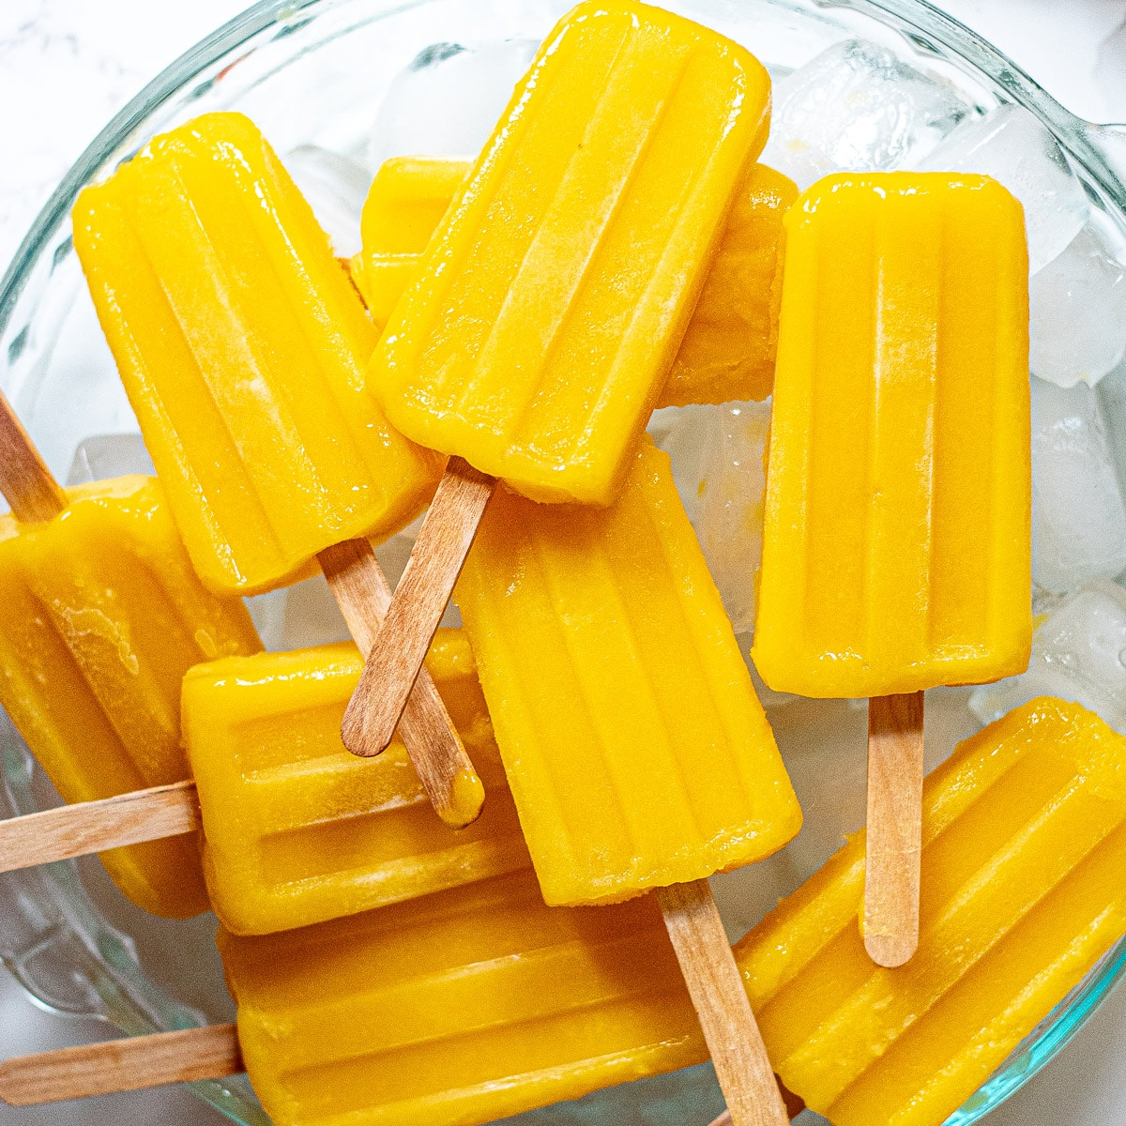
VARIETY OF POPSICLES
Mango Popsicle

Slide 6
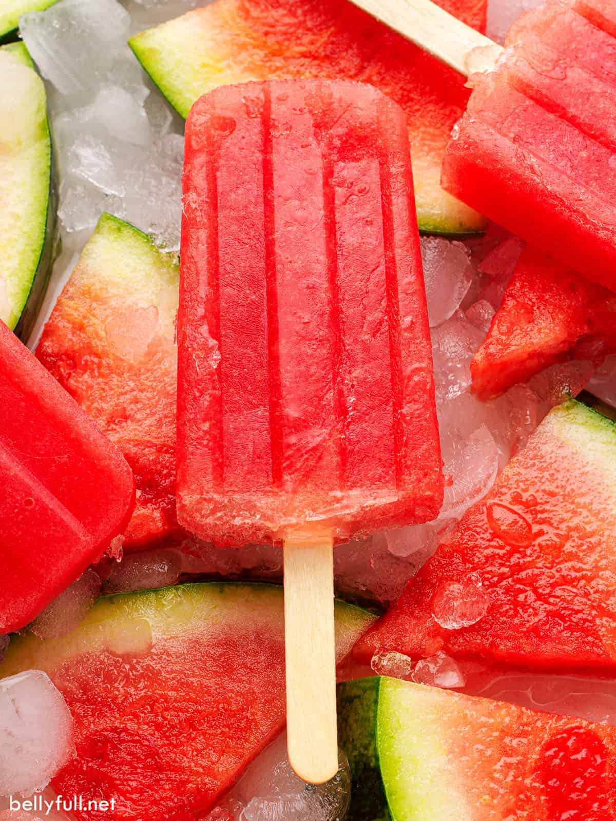
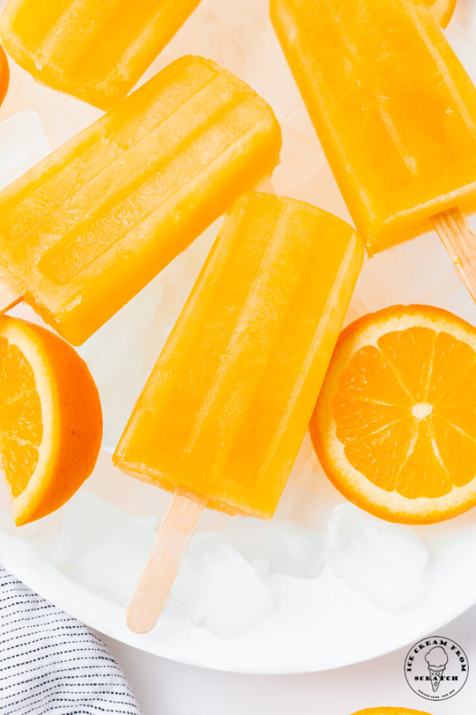
Watermelon Popsicle Orange Popsicle

Slide 7
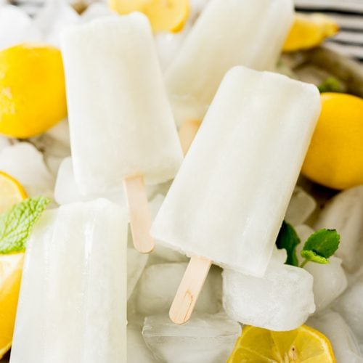
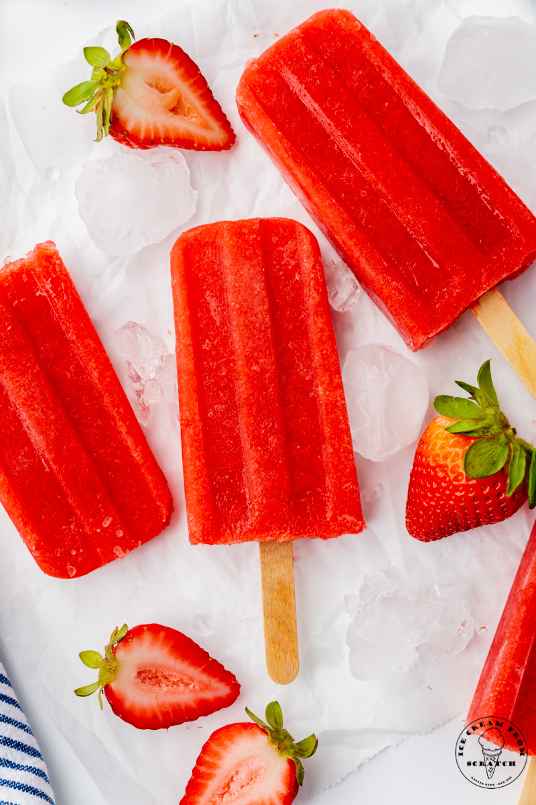
Lemon Popsicle Strawberry Popsicle

Slide 8
Why I have opted this topic?
High market demand and growing industry.
High profitable business with low investment.
It can be start in a small plan.
It doesn’t require too much compared heavy machinery.
Manpower requirement is very less and less skills requirements.
Manufacturing procedure is very simple.
Doesn’t require too much license except FASSAI and trade license.
Marketing is very simple because of high demand in populated areas.

Slide 9
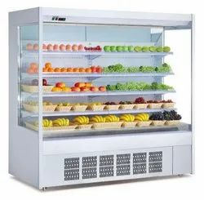
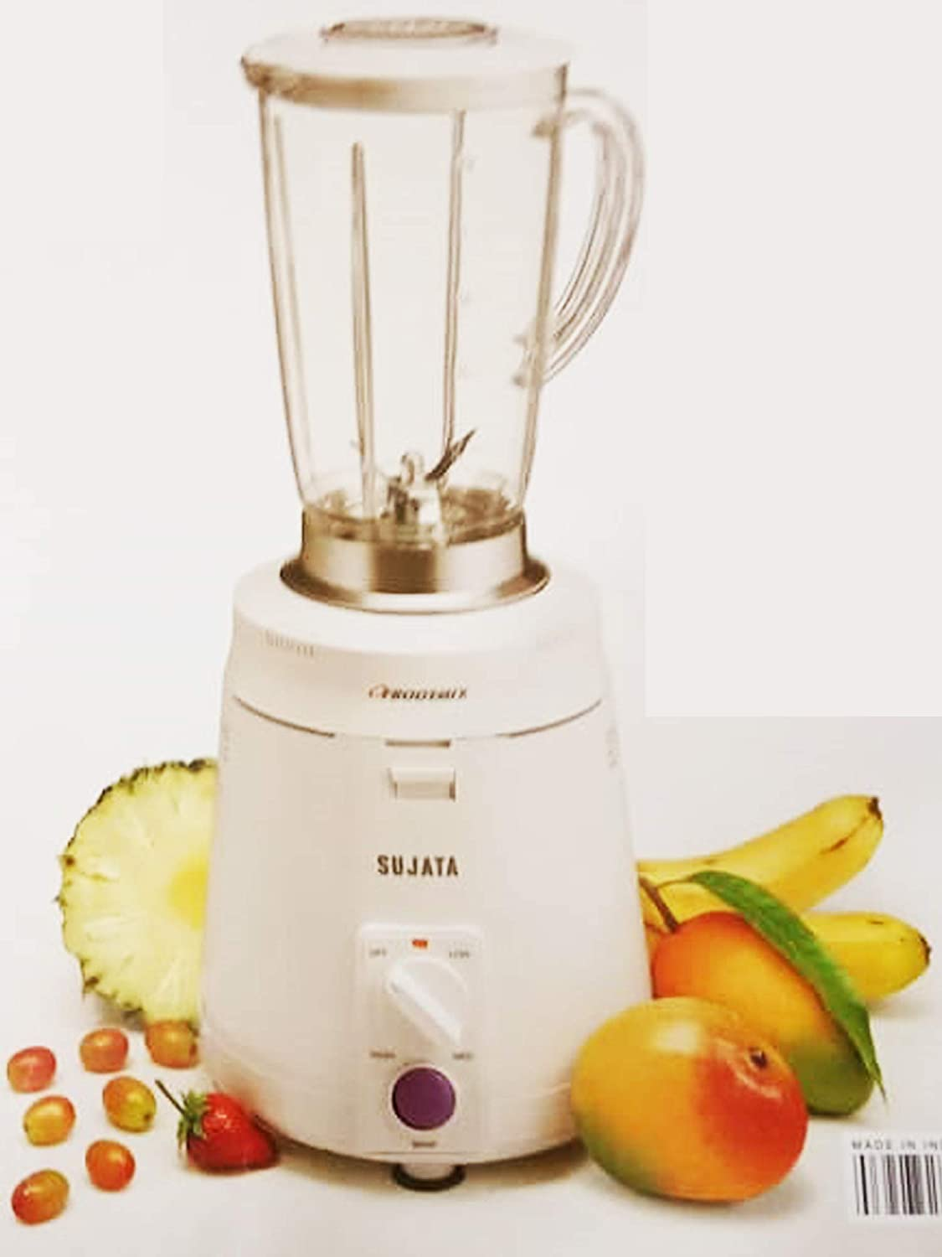
Machinery requirements for popsicle manufacturing:-
Large Refrigerator:-
MIXTURE GRINDER:-

Slide 10
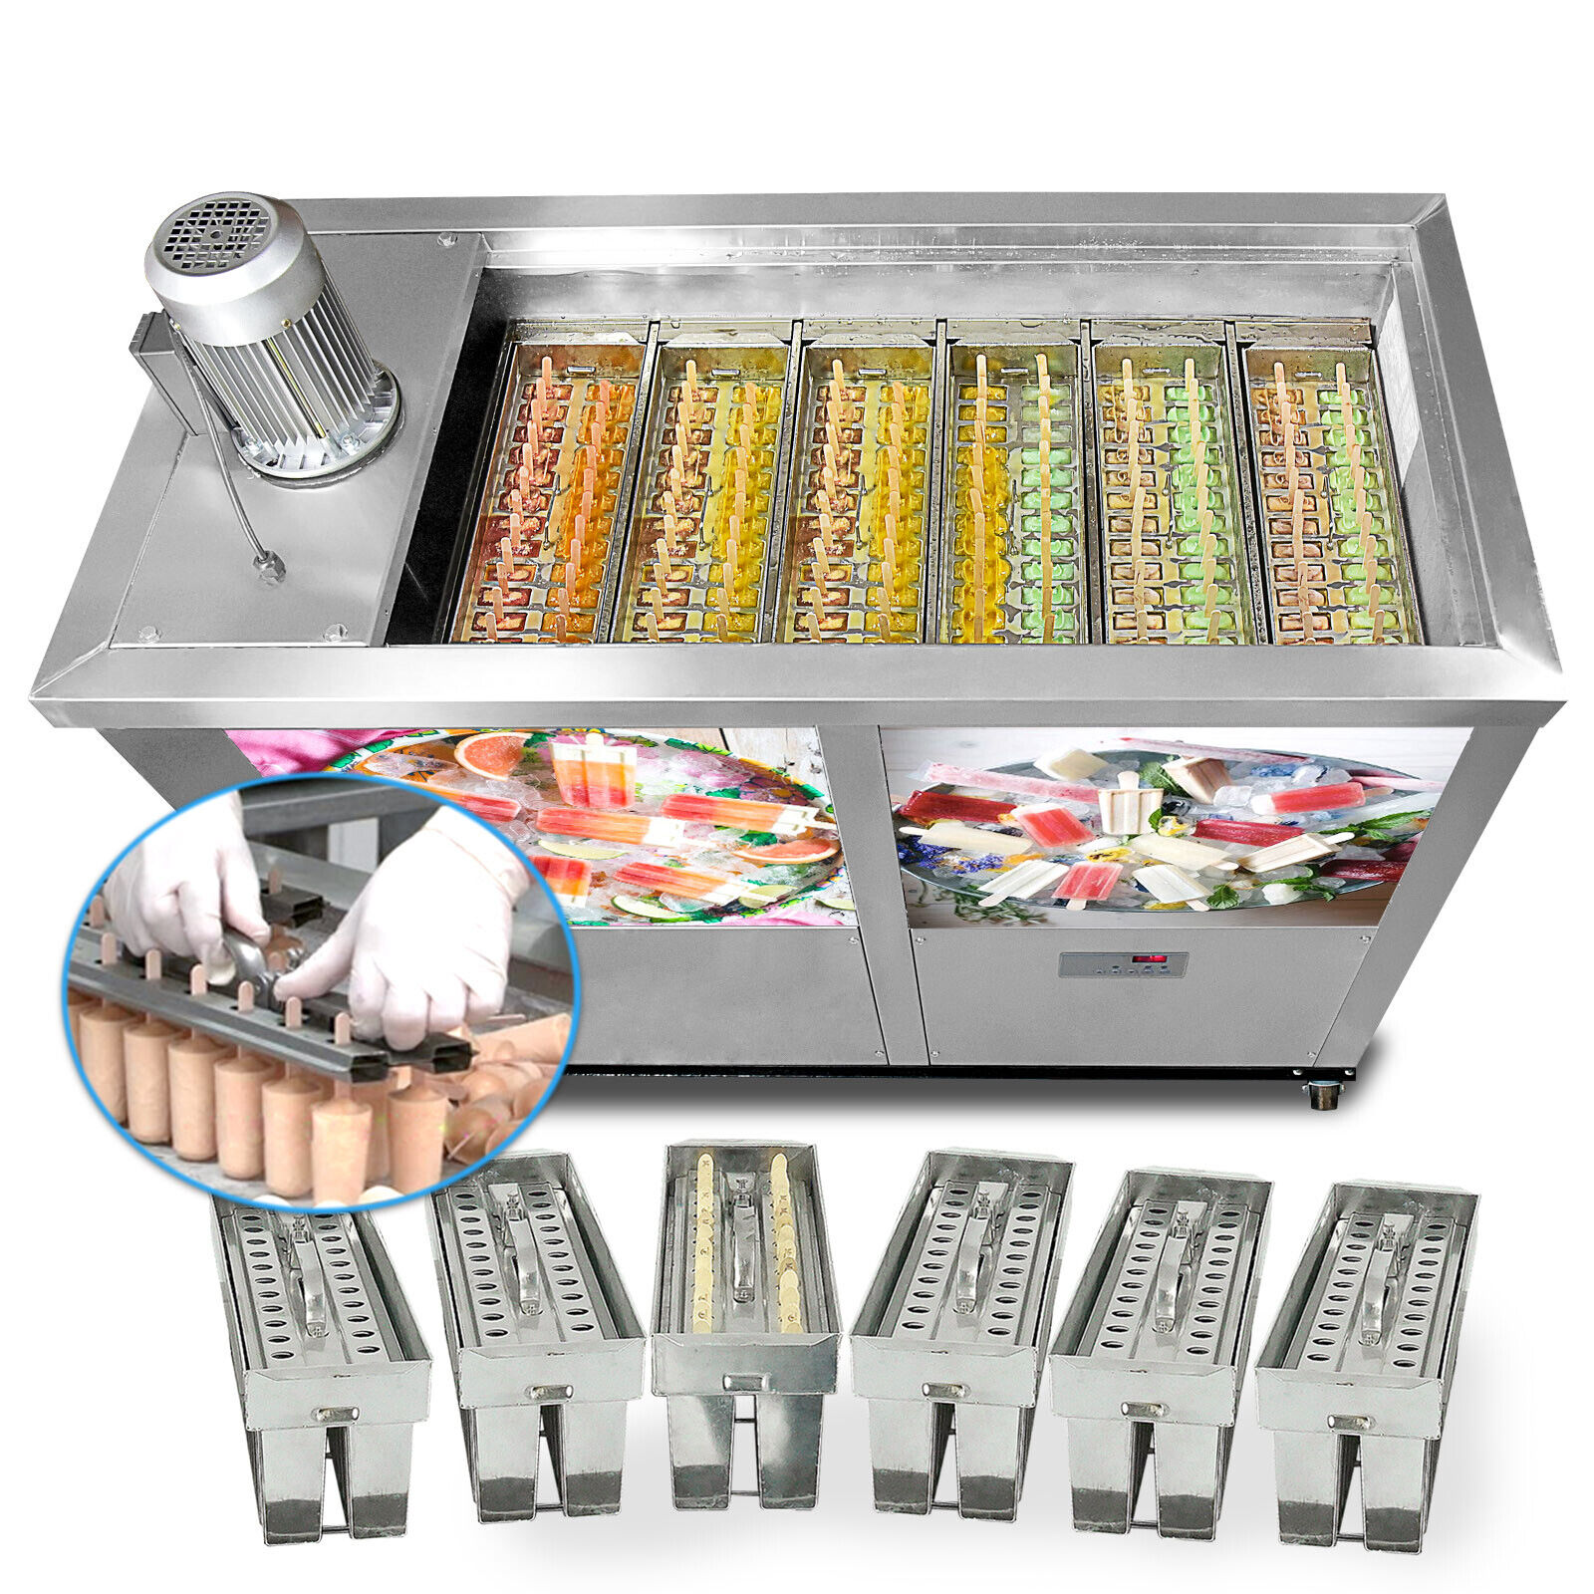
3.Popsicle manufacturing machine:-

Slide 11
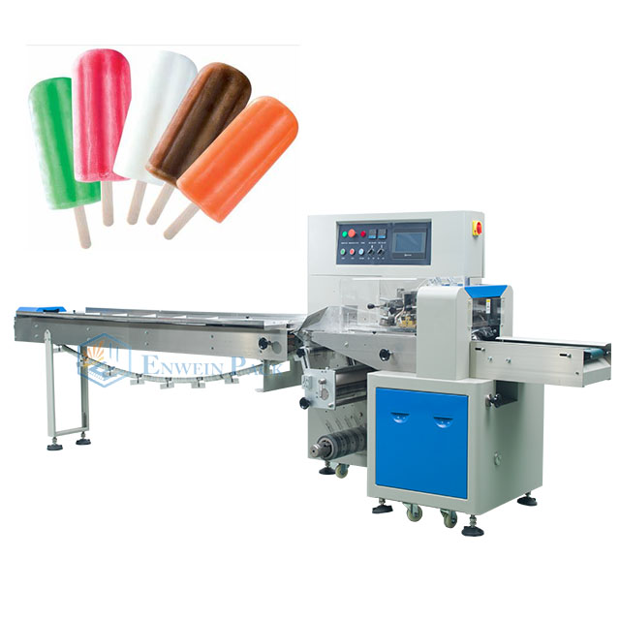
4.Packageing machine:-

Slide 12
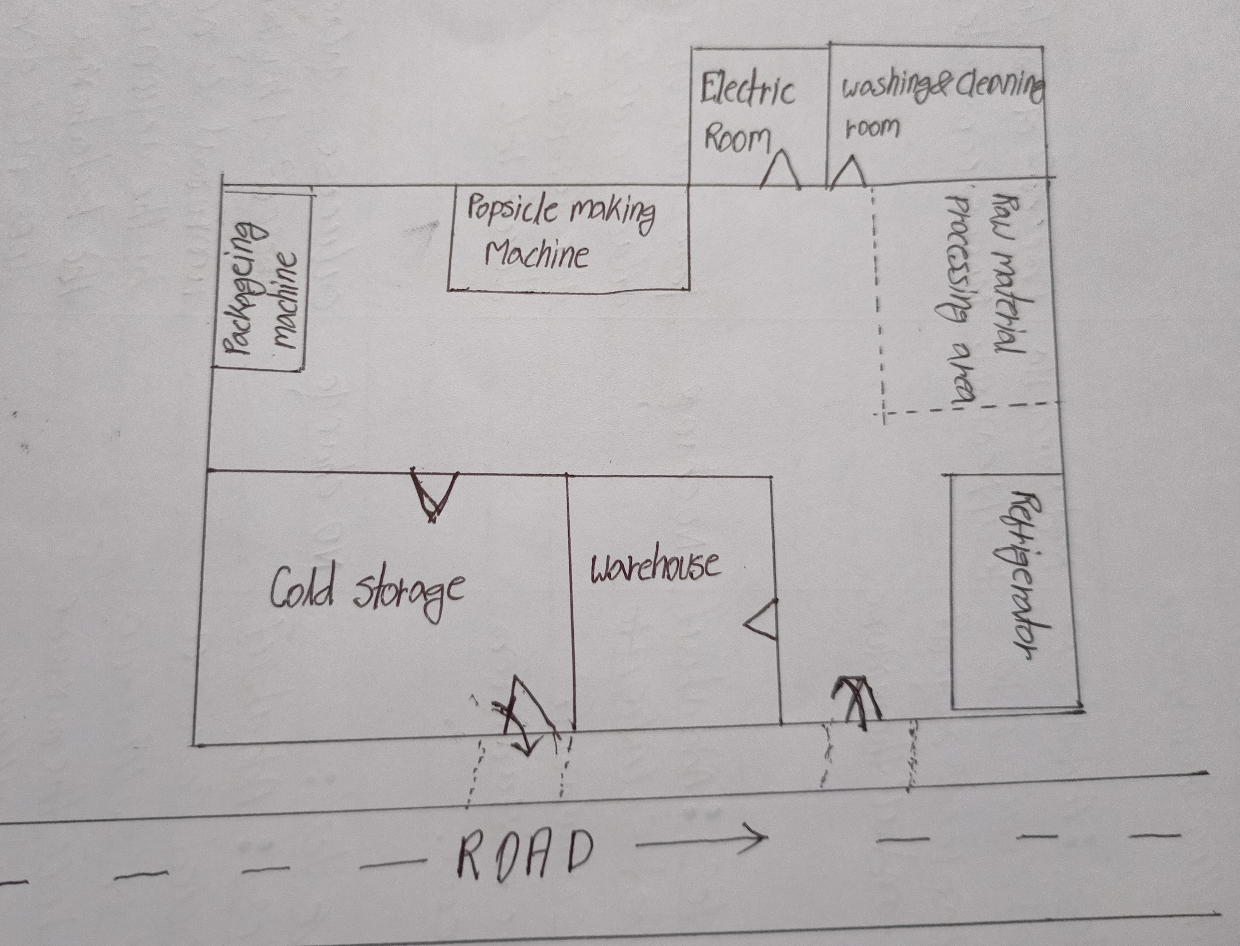
PLANT LAYOUT:-

Slide 13
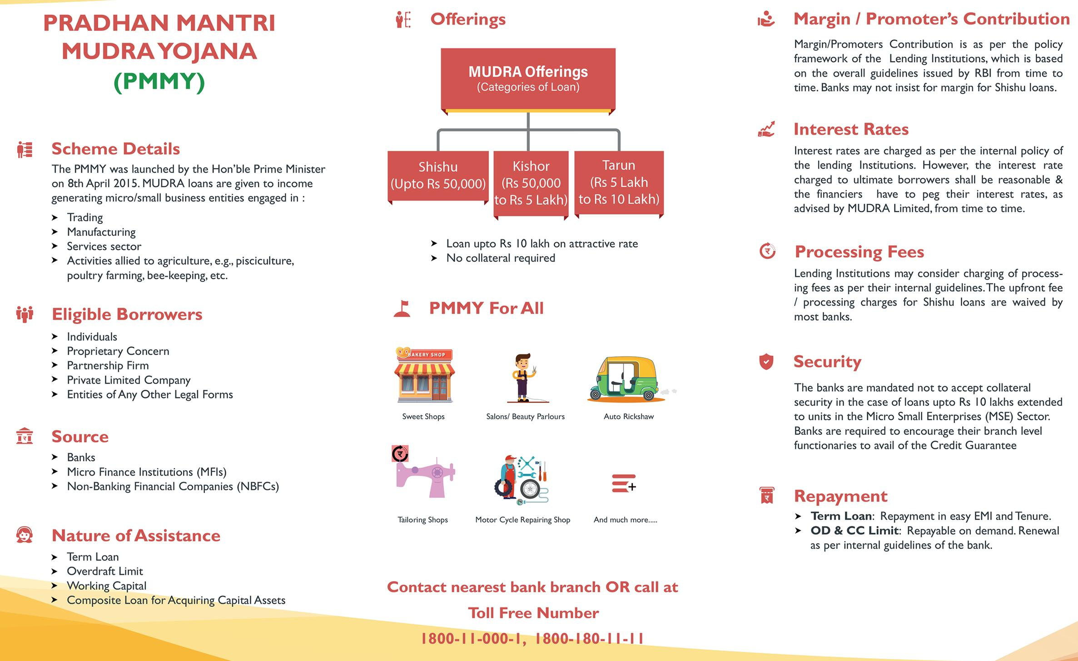
HOW I WILL GET LOAN FOR BUSINESS?

Slide 14
MANUFACTURING PROCEDURE:-
Wash the fruits and extract the fruity portion from them
Grind the fruity portion by adding water with the help of mixer grinder and collect them into the container
Adding water, saccharine colours, flavours with the Juice and mix them properly so that it increase the quantity test and colour.
Fill the popsicle mold template by the mixed solution.
Add popsicle sticks with them and close the cover
Dip those popsicle mold into the glycol and water mixture solution at -25°C temperature.
After 10-12 minutes later open the cover remove the mold and dip into the normal water and separate the popsicle from the template.
Collect the popsicles and package them with the help of packing machine.
Store the popsicles into the coal store.

Slide 15
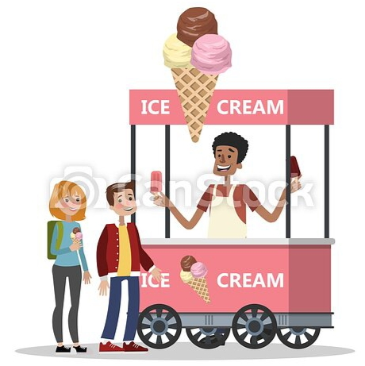
MARKETING:-

Slide 16
THANK YOU

