Slide 1
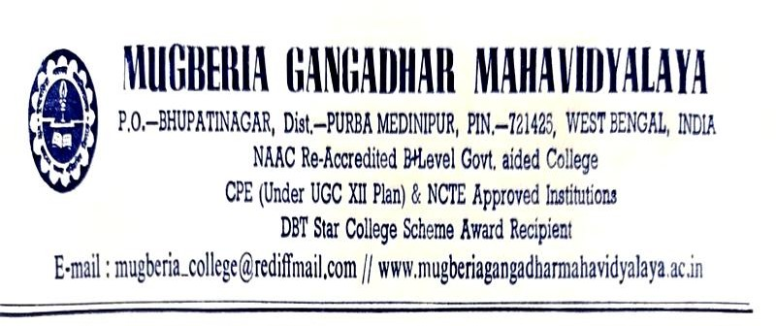
TEACHERS DAY

Slide 2
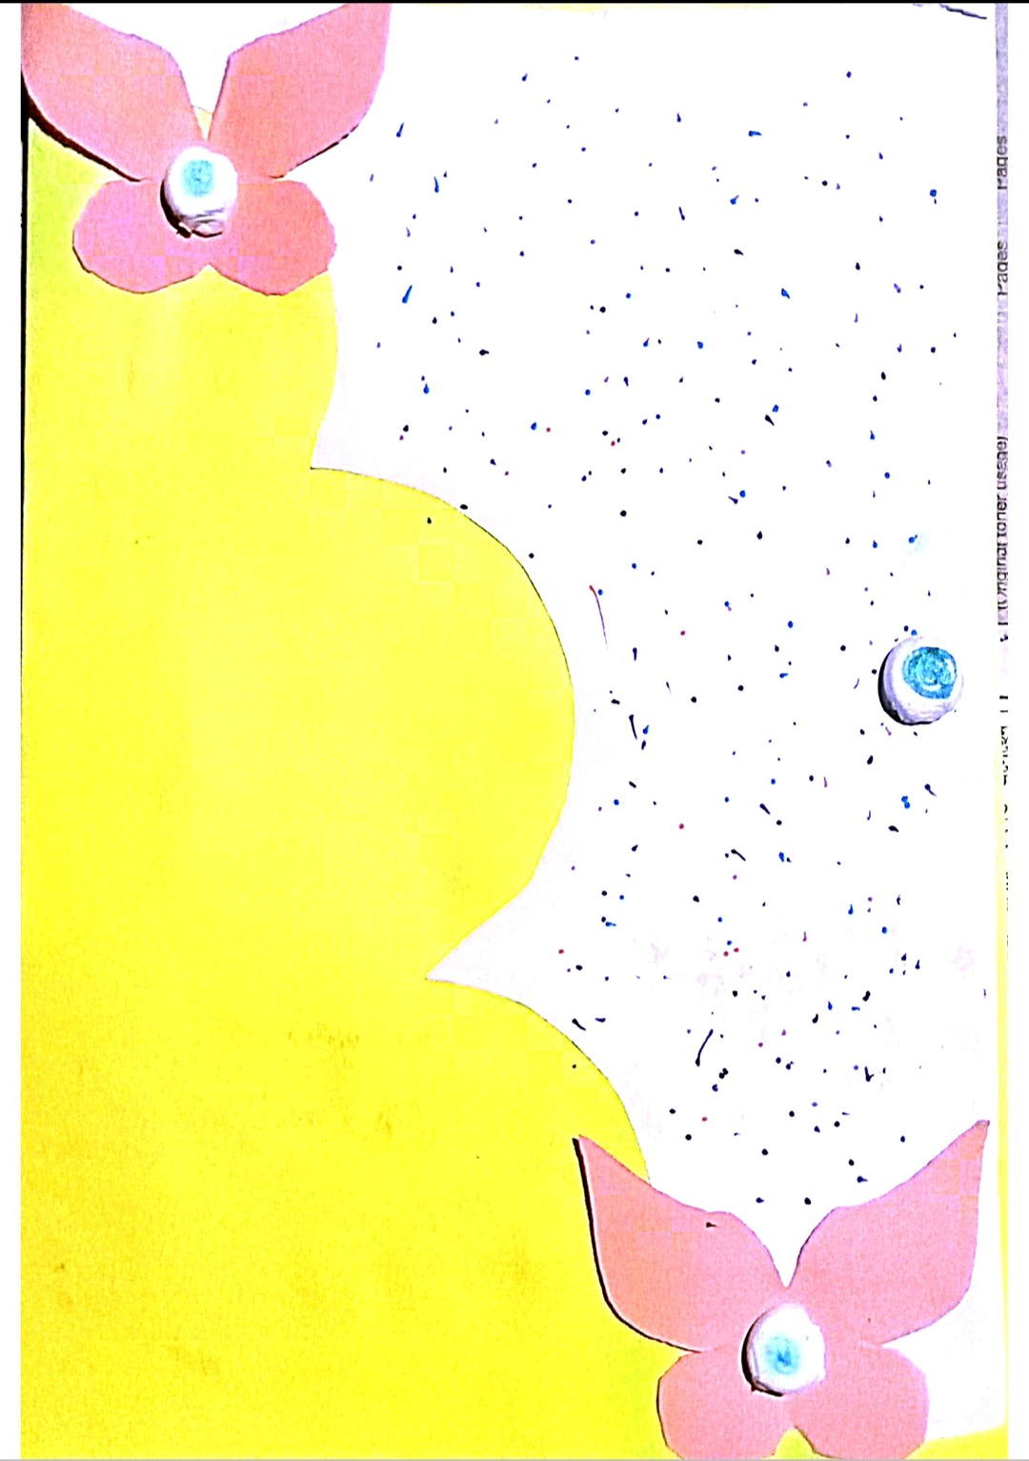
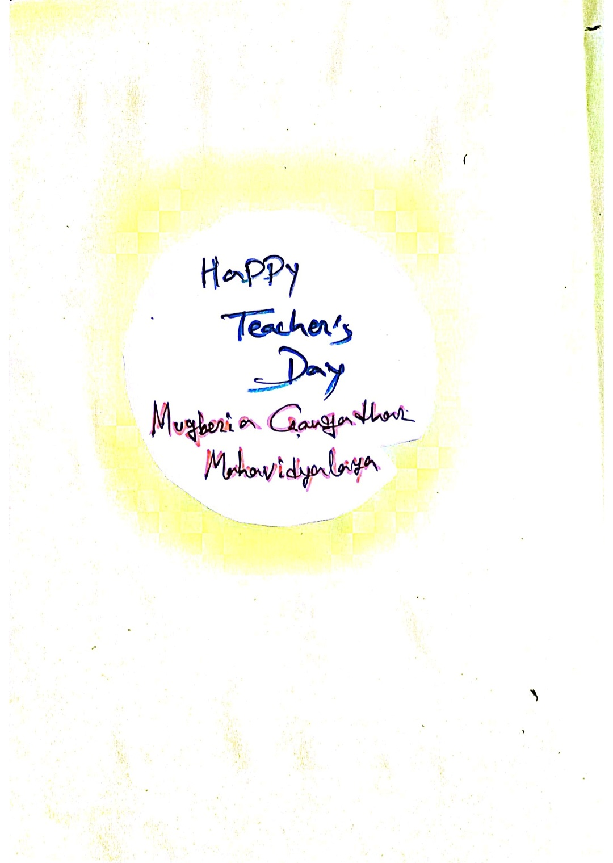
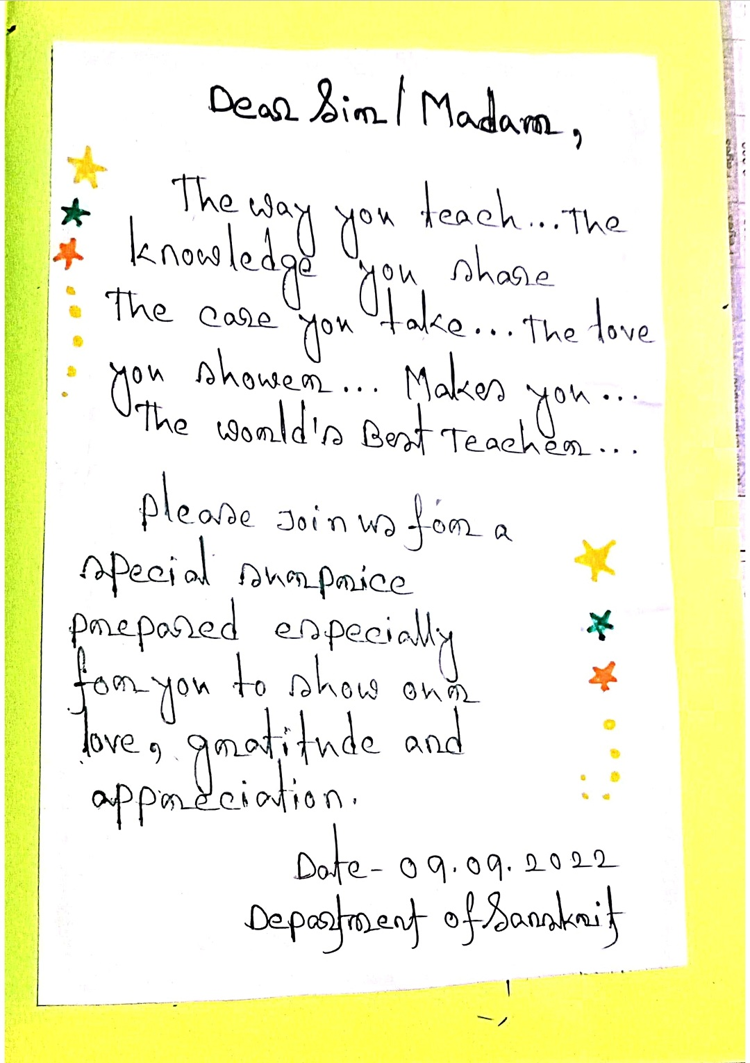
Day
YG
Department of Sanskrit
Mugberia Gangadhar Mahavidyalaya
Date: 09/09/2022

Slide 3
REPORT ON TEACHER'S DAY CELEBRATION
9th September 2022
Organized by
Department of Sanskrit
Mugberia Gangadhar Mahavidyalaya
Bhupatinagar, Purba Medinipur,721425, W.B
The most auspicious Teachers Day was celebrated with the inmost aim and intensity and moral purity at the initiative of the Department of Sanskrit in the benign presence of Professor. Dr. Swapan Kumar Misra, Principal in association of students and teaching faculties. At the beginning of the meeting the welcome address was conducted by Dr.Manoranjan Das, Associate Professor and H.O.D Sanskrit by self composed Sanskrit Verses for the shake of distinguished dignitaries. At the out set Principal Sir Dr. Swapan Kumar Misra delivered the keynote of the programme. Dr. Bidhan Chandra Samanta, Secretary, Teachers Council addressed the students on the divinity and austerity of Teachers Day as Chief Guest. Teaching wing of the Department delivered their experienced discourses. Every body of the programme became over whelmed with ecstasy by the miraculous dance of Anwesha Dinda, a student of Sem- V. Meeting was ended by the grateful Vote of thanks to the Chairs by our Respected Madam Dr. Sutapa Giri (Pradhan). The entire programme was pleasant, effulgent with glory and grace in the sacred soil of Mugberia Gangadhar Mahavidyalaya, Bhupatinagar, Purba Medinipur, West Bengal on 9th September 2022.

Slide 4
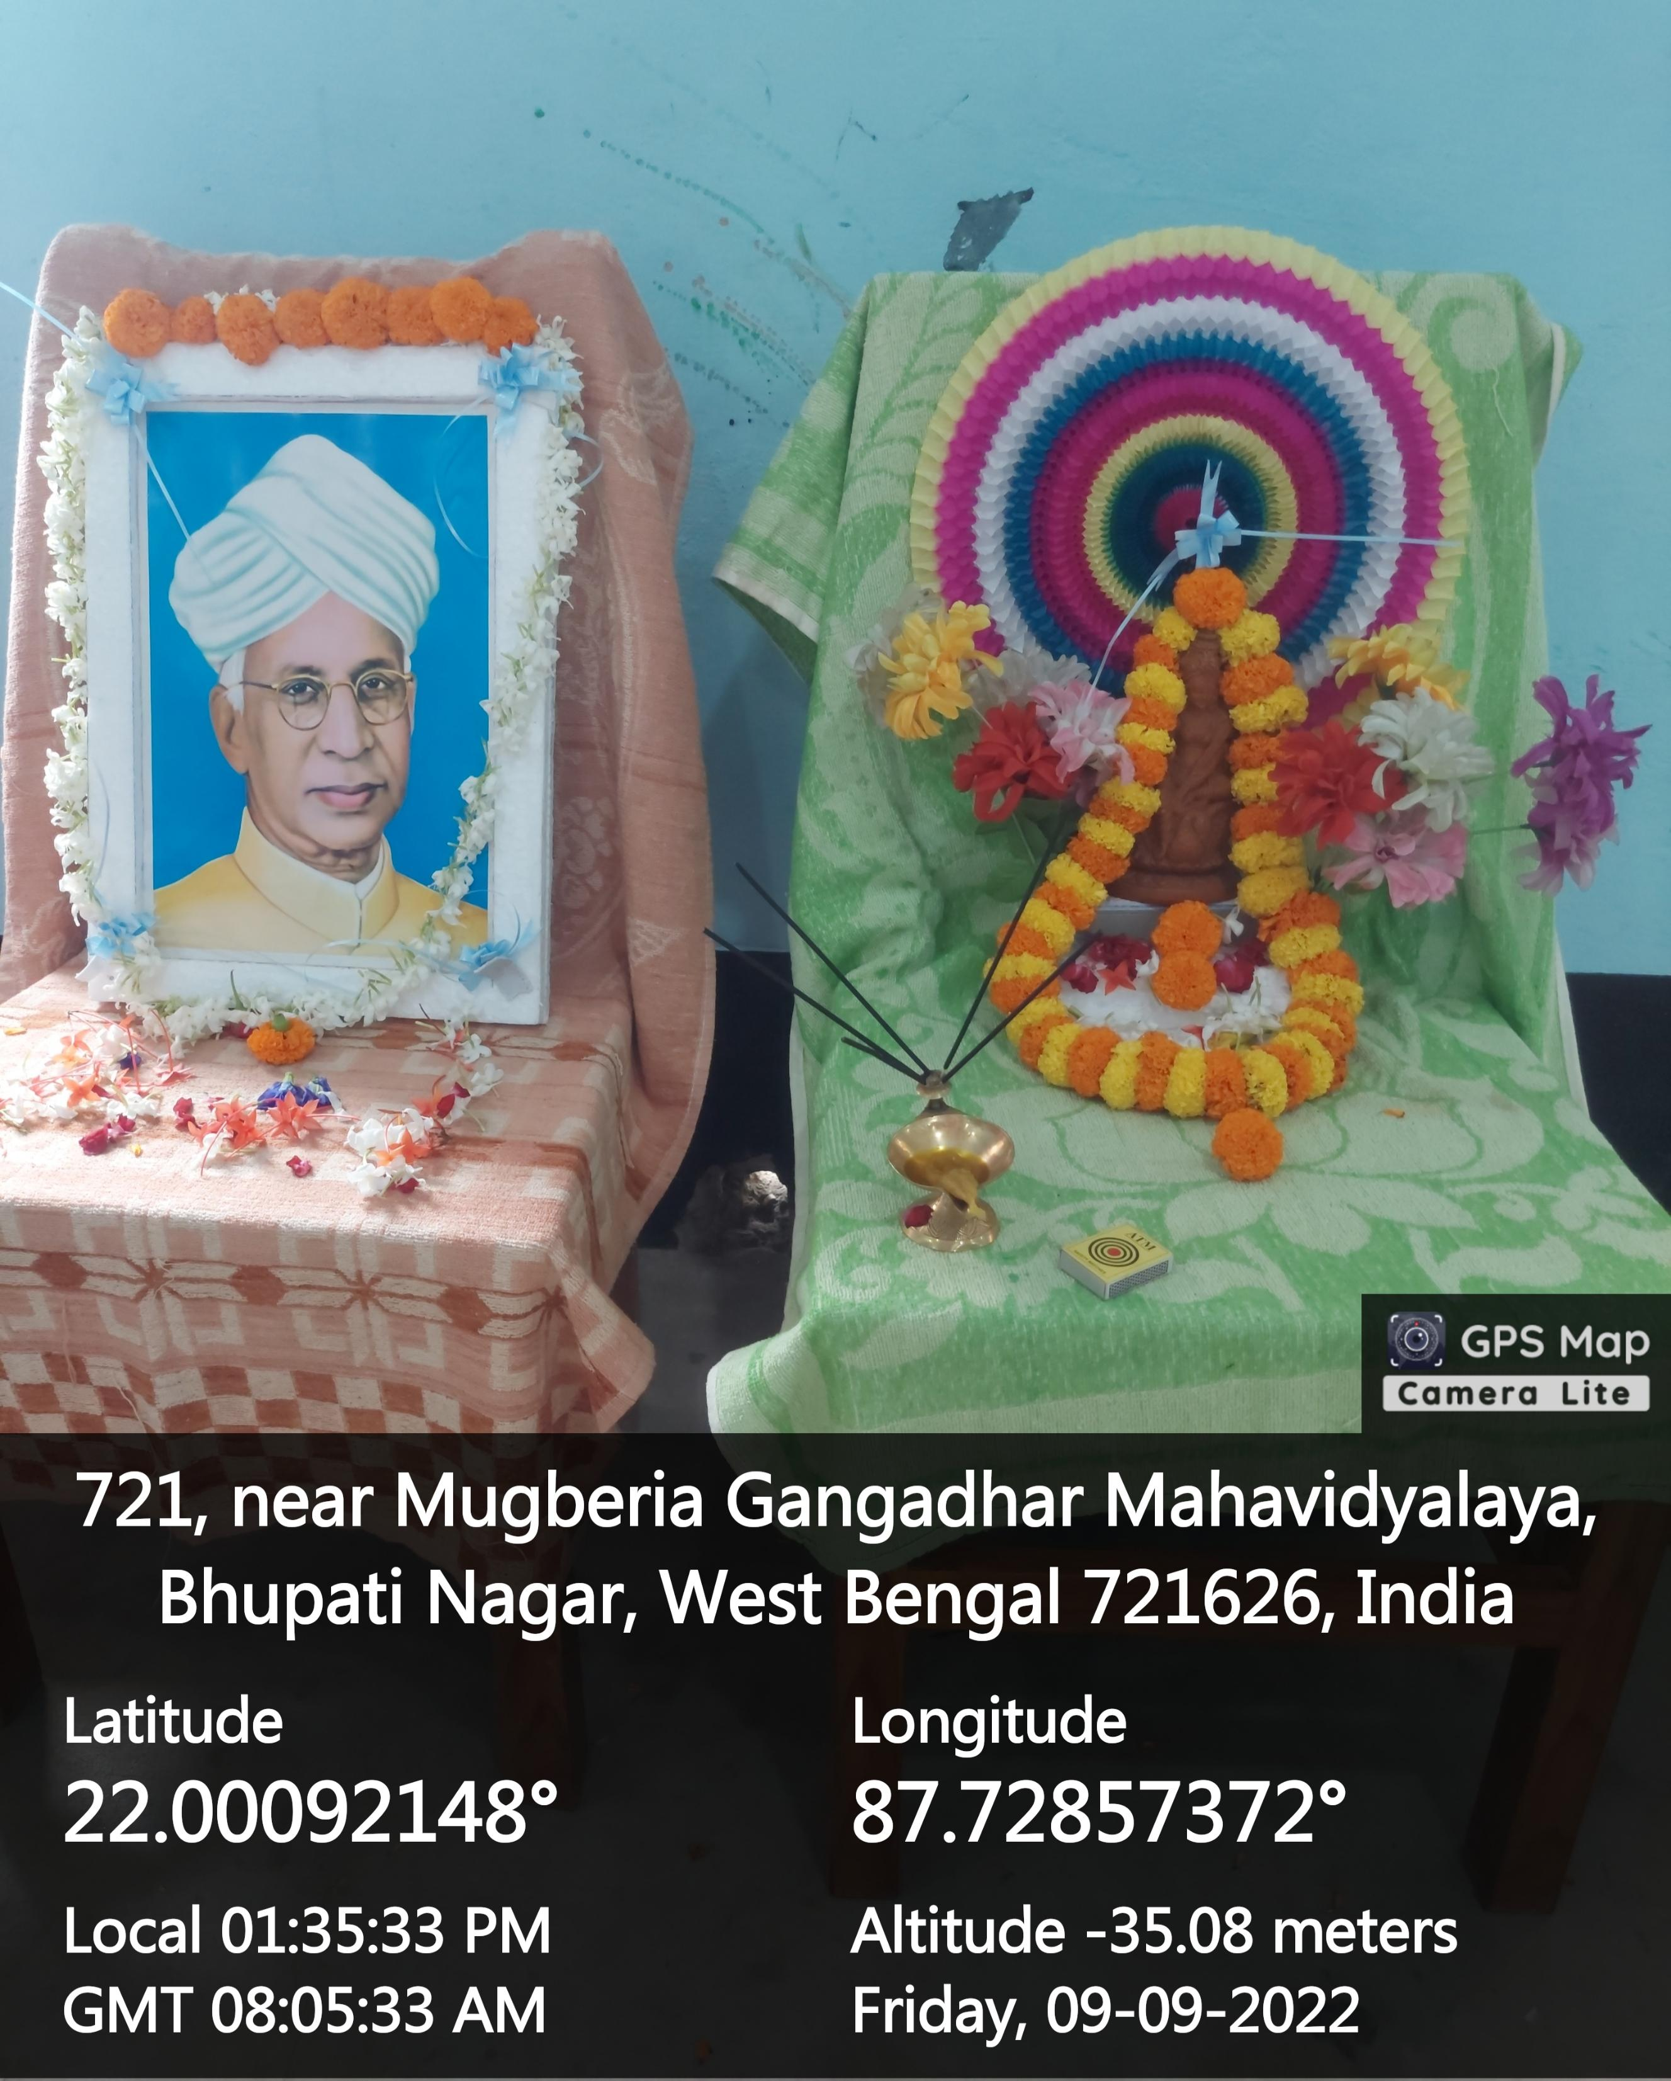
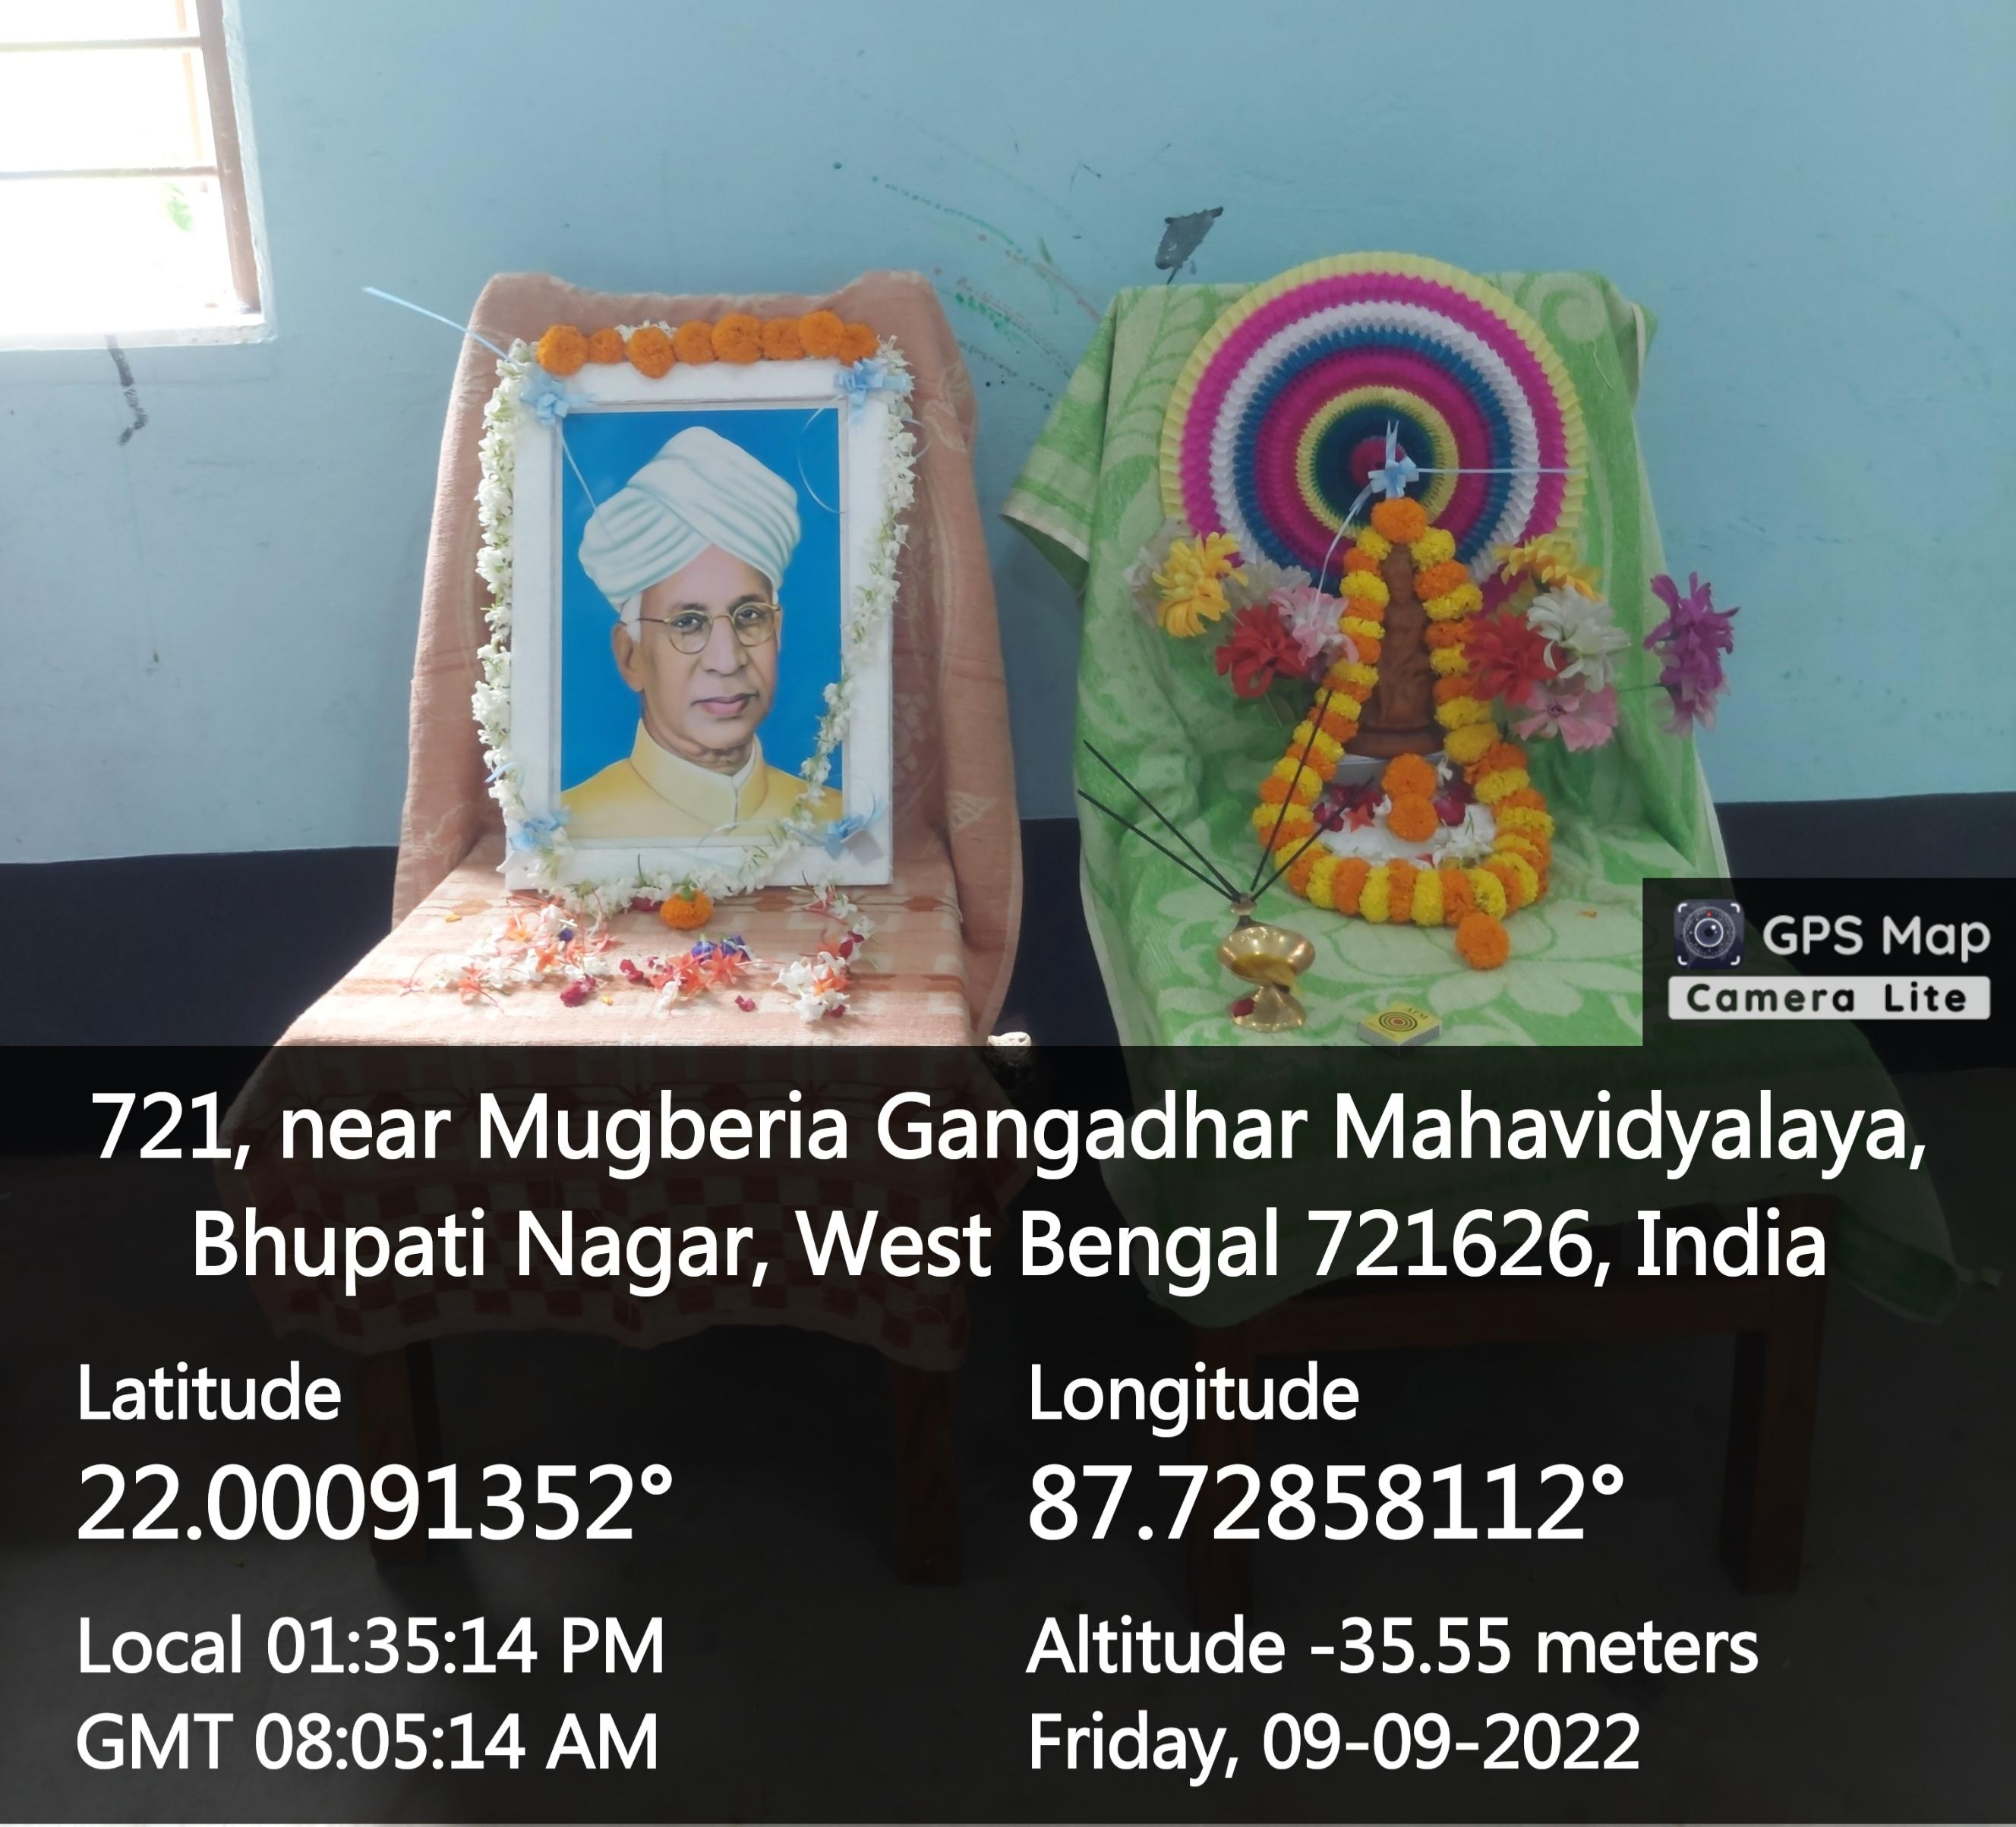
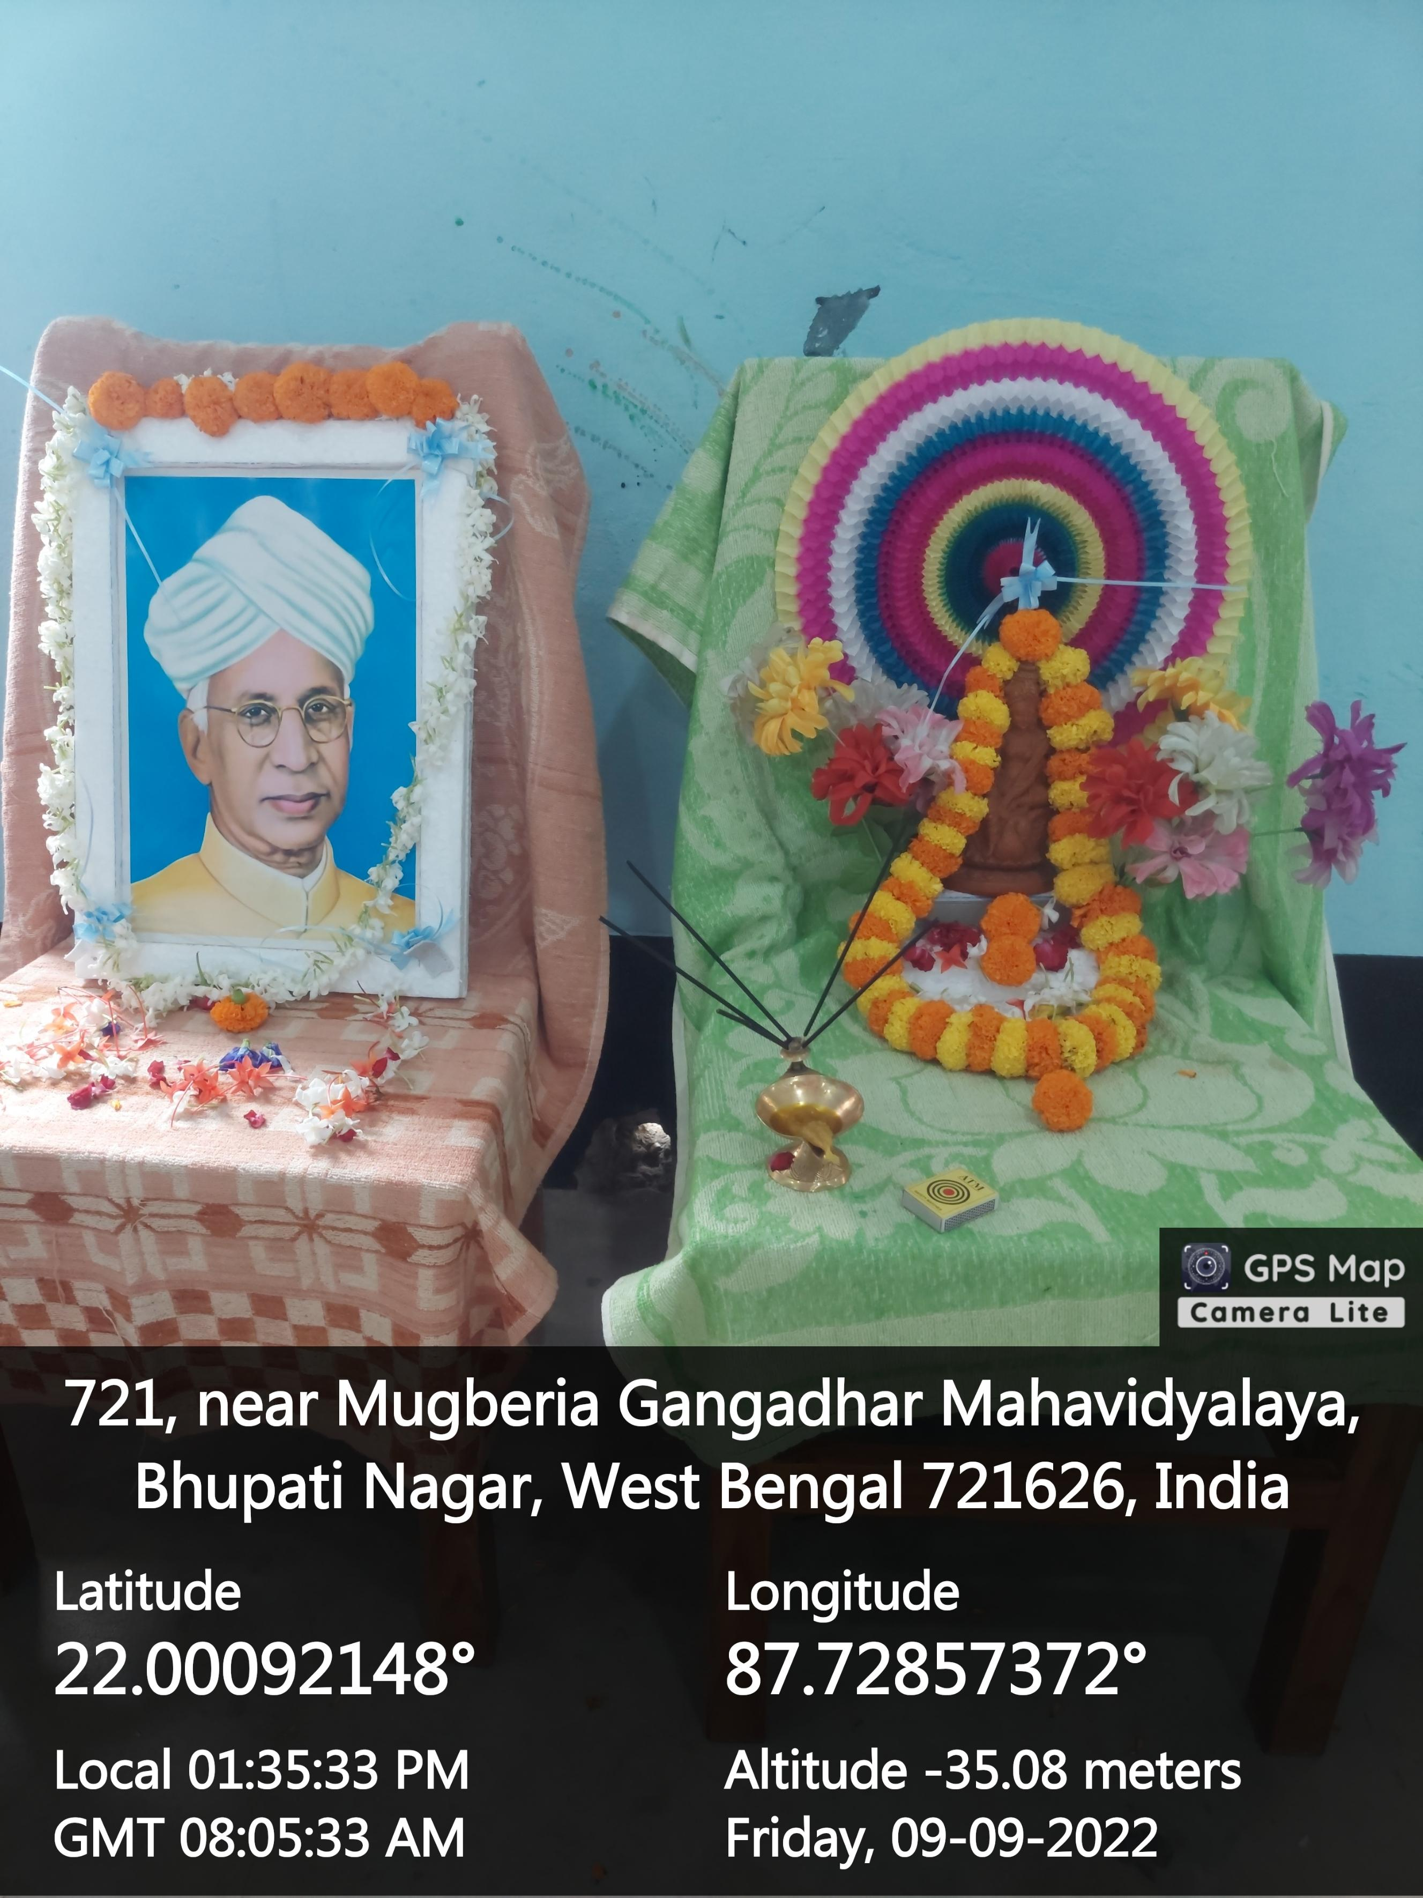

Slide 5
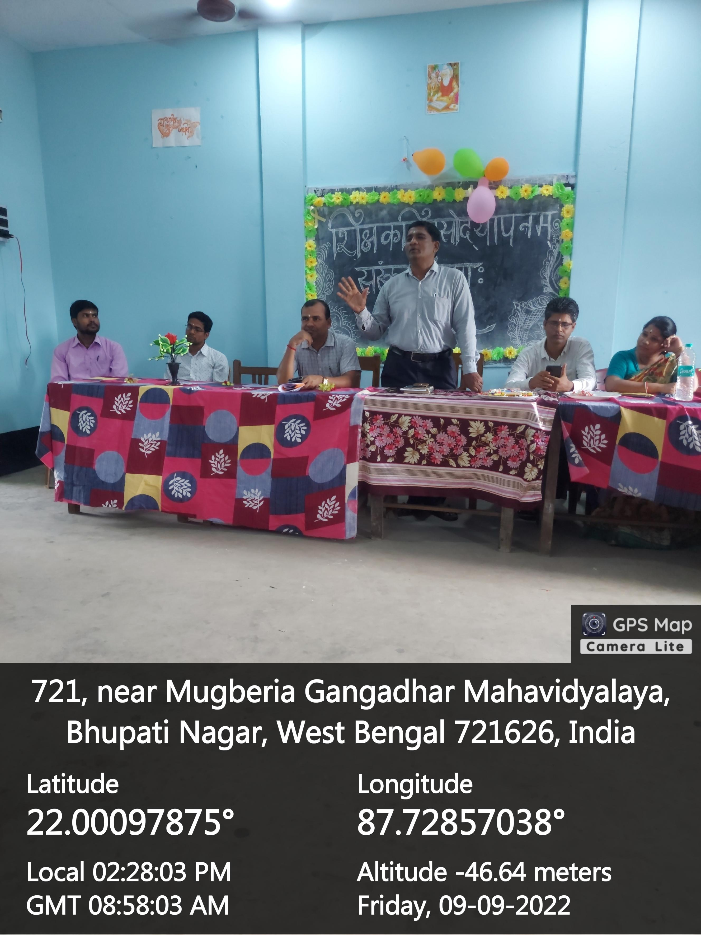
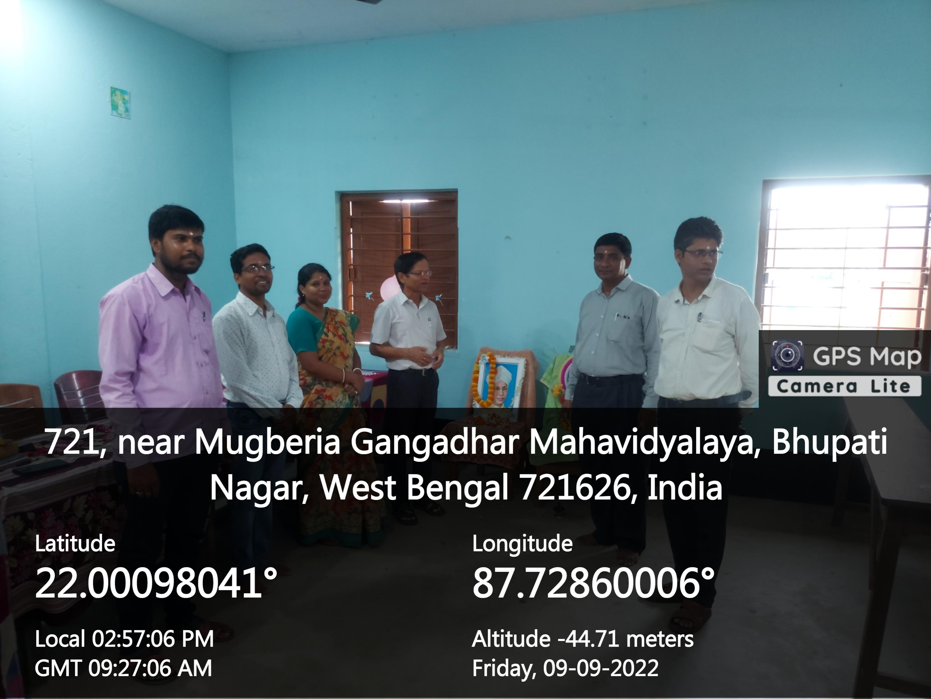
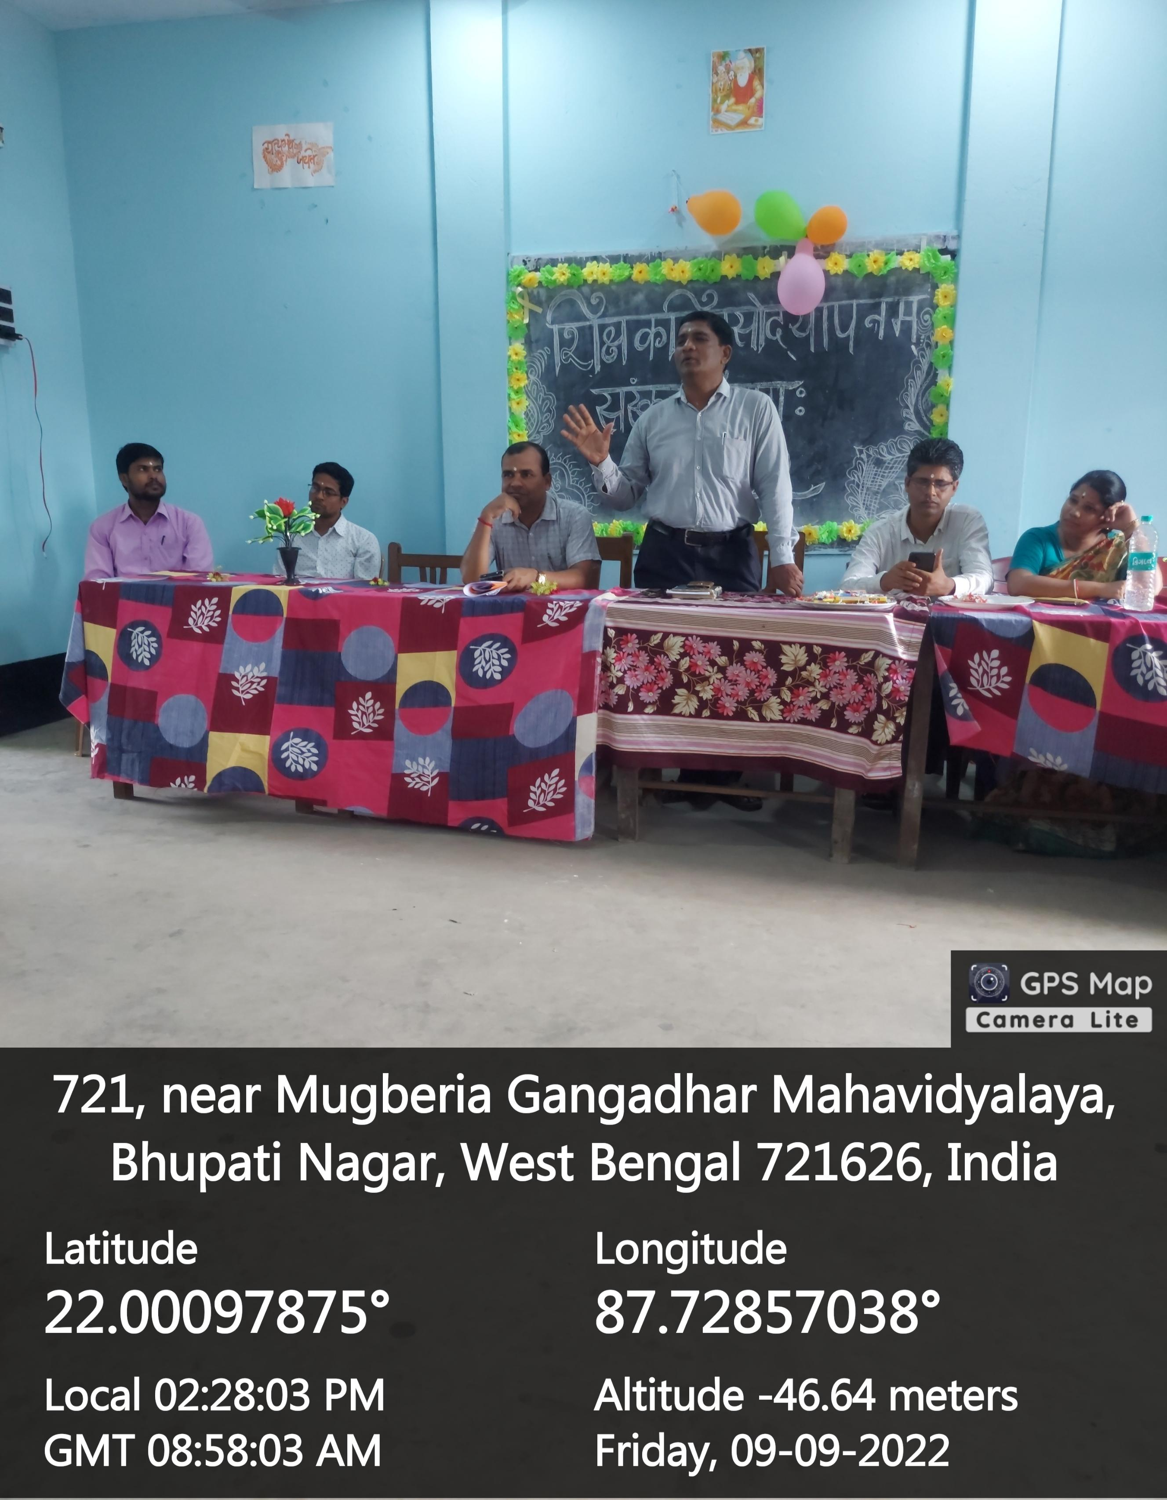

Slide 6
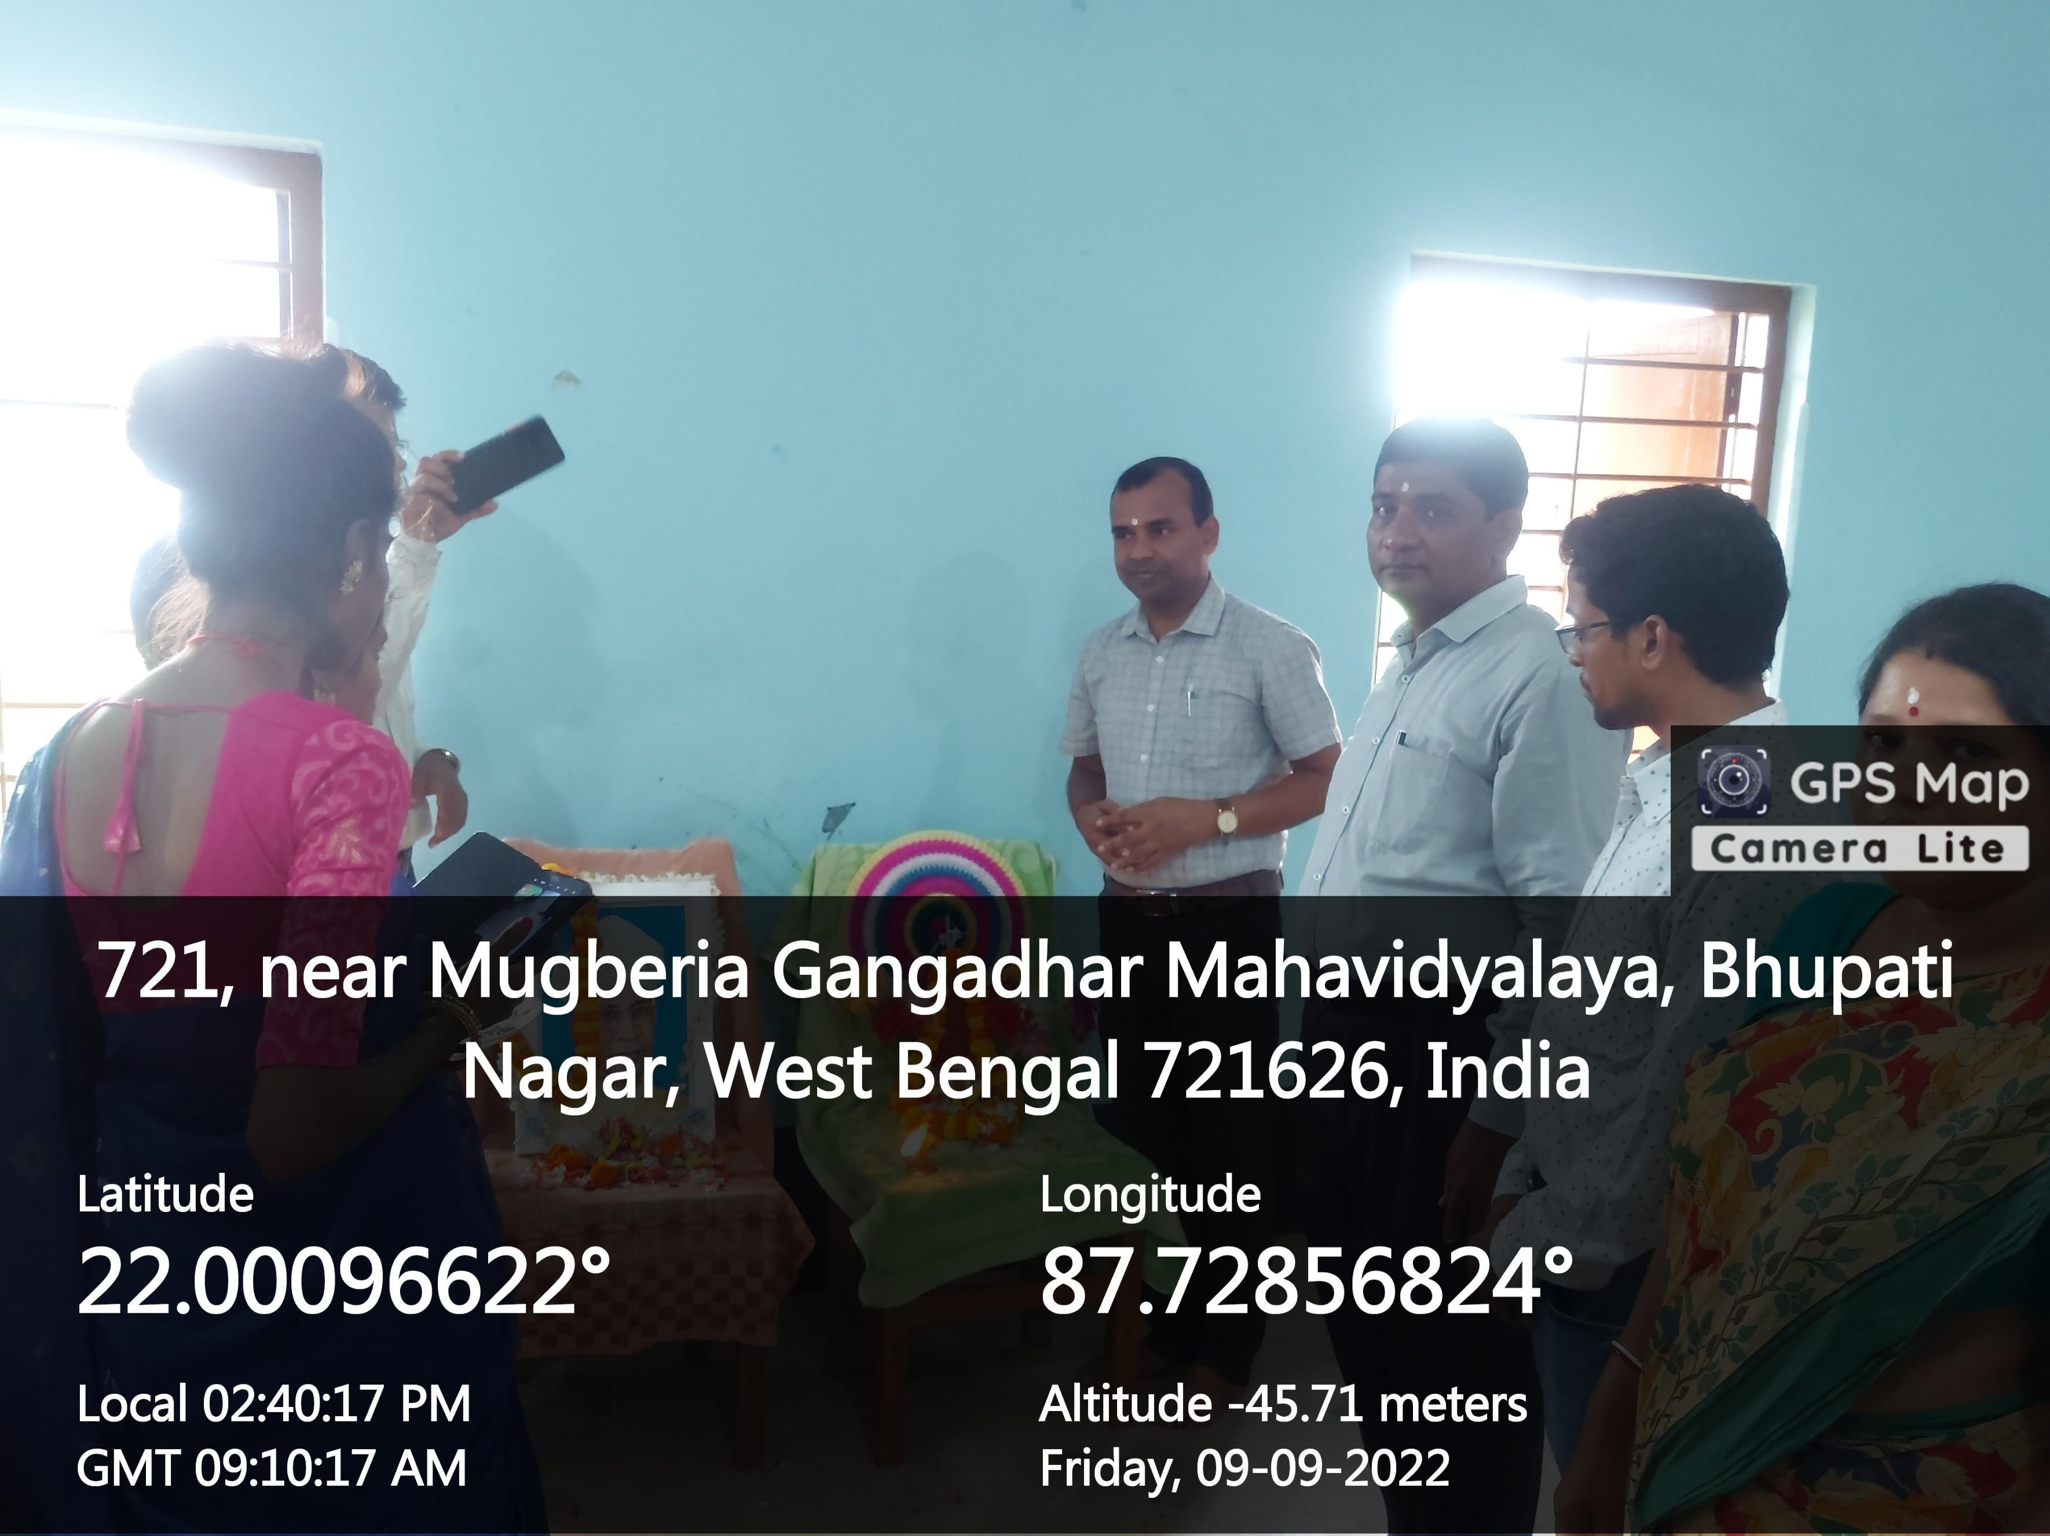
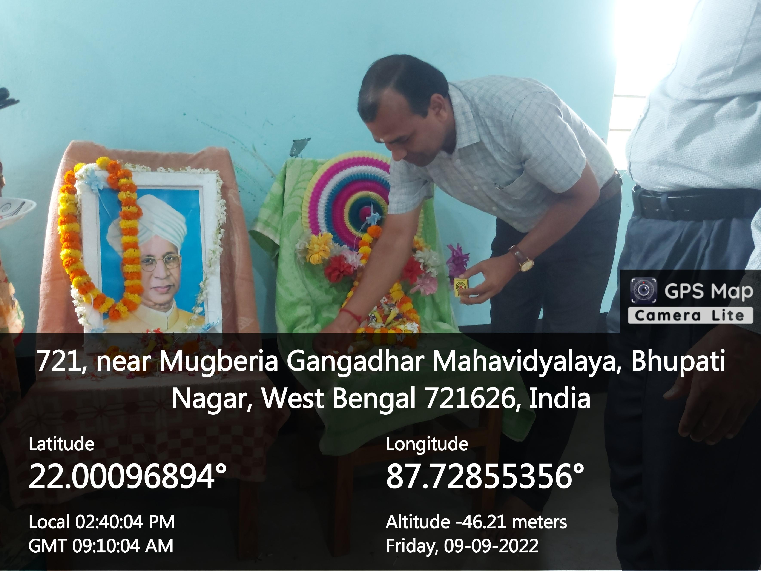

Slide 7
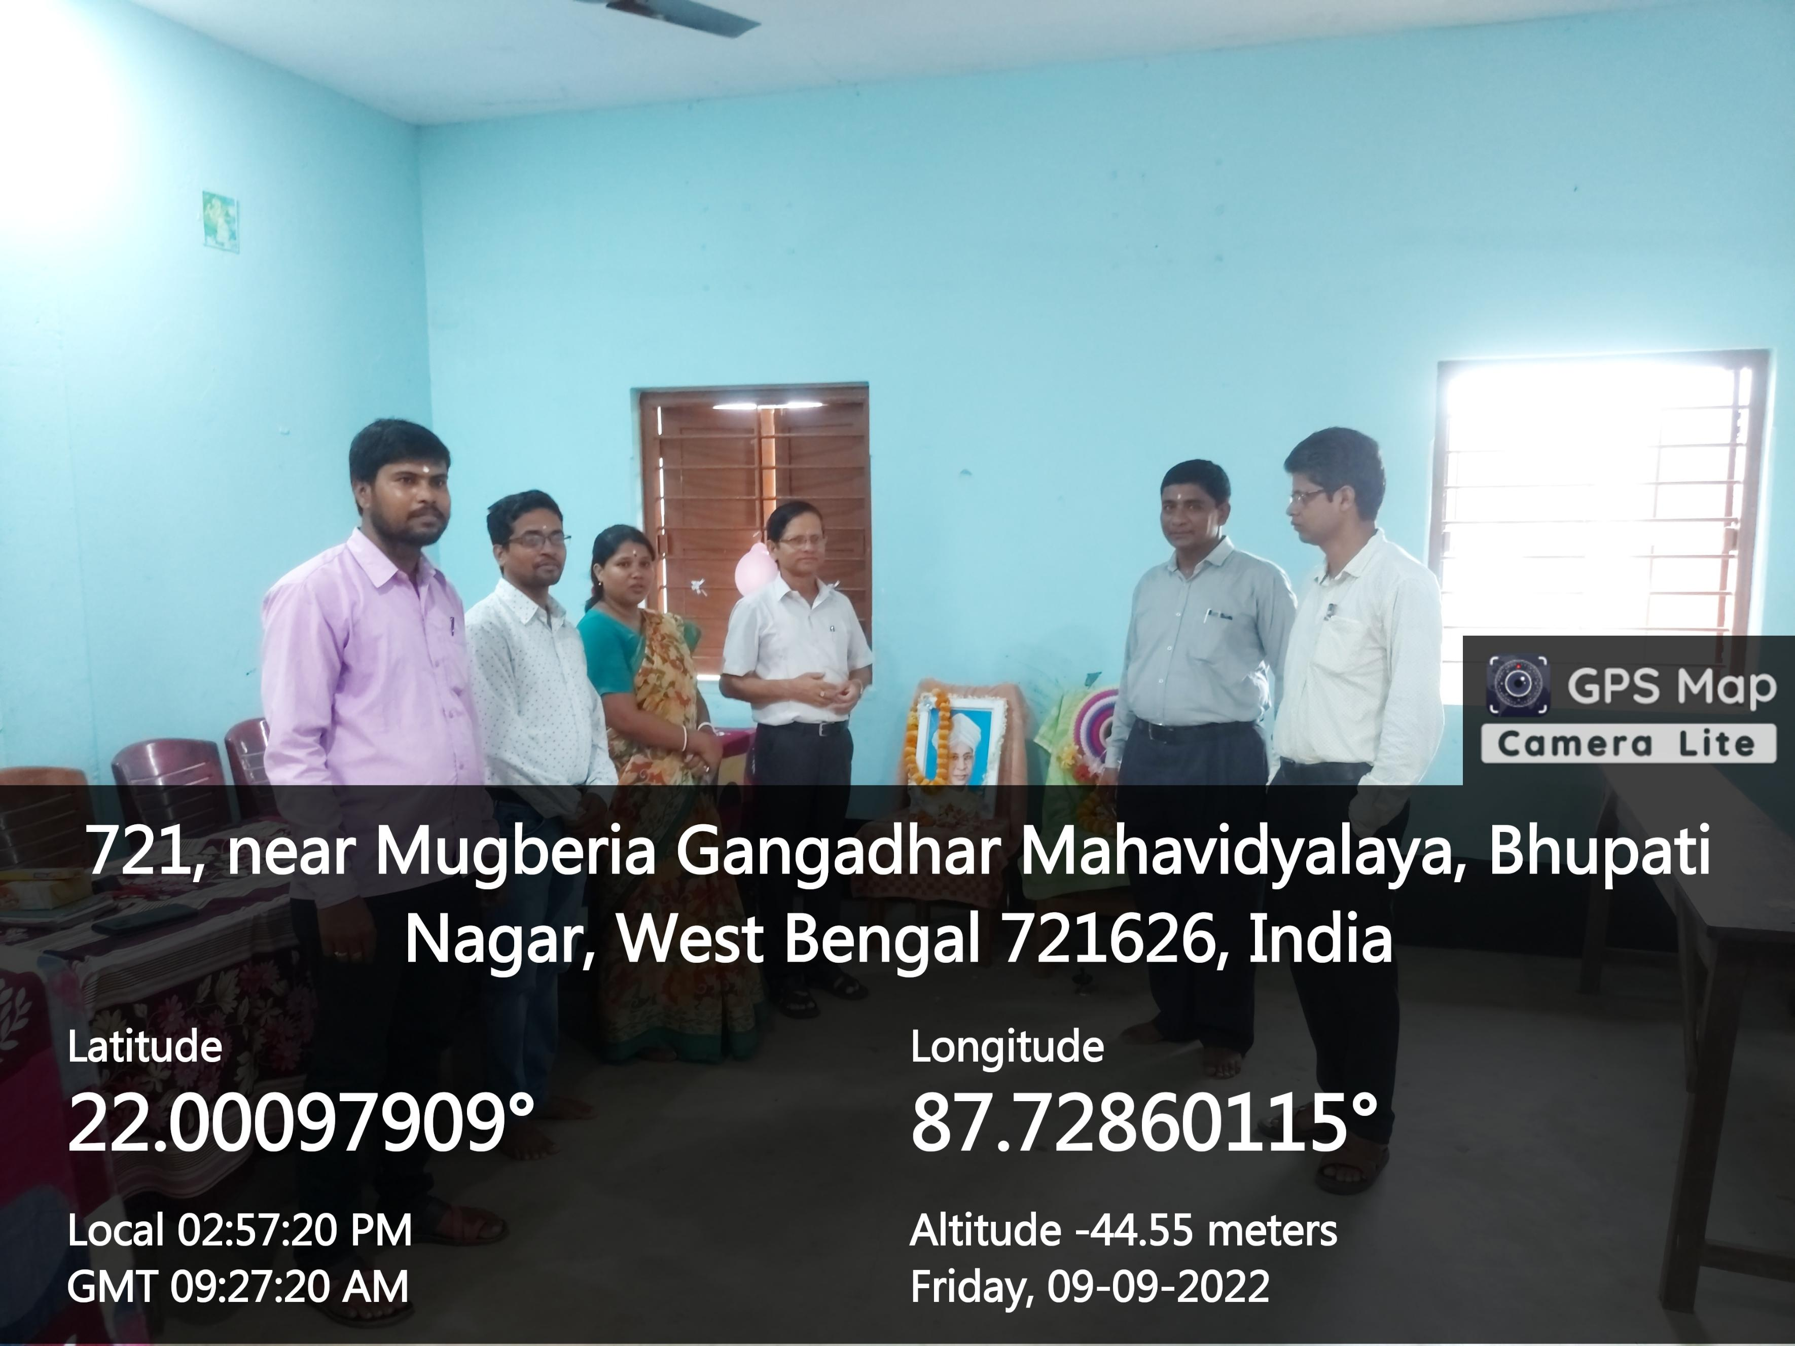
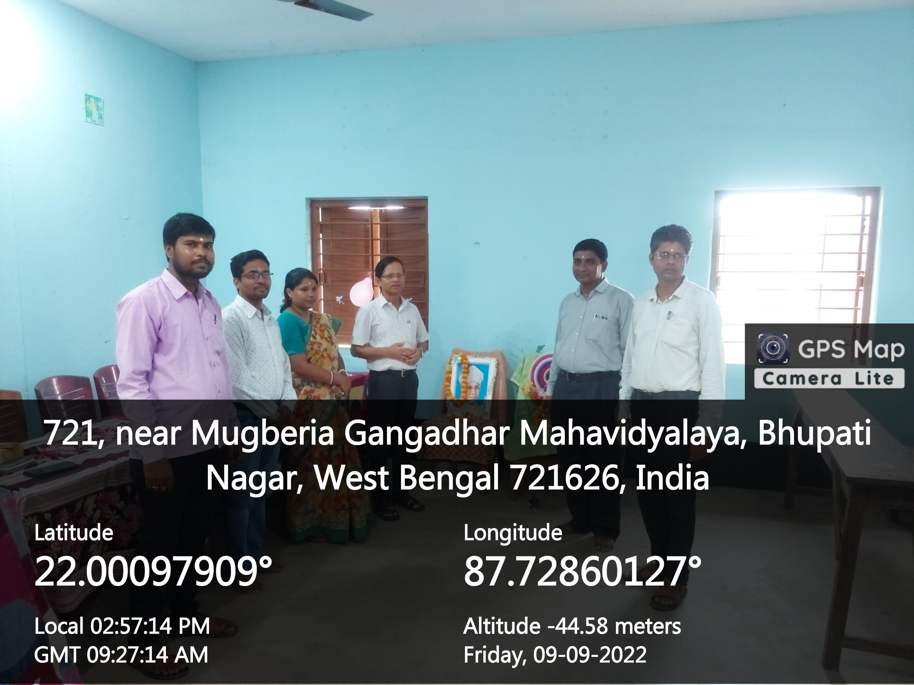

Slide 8
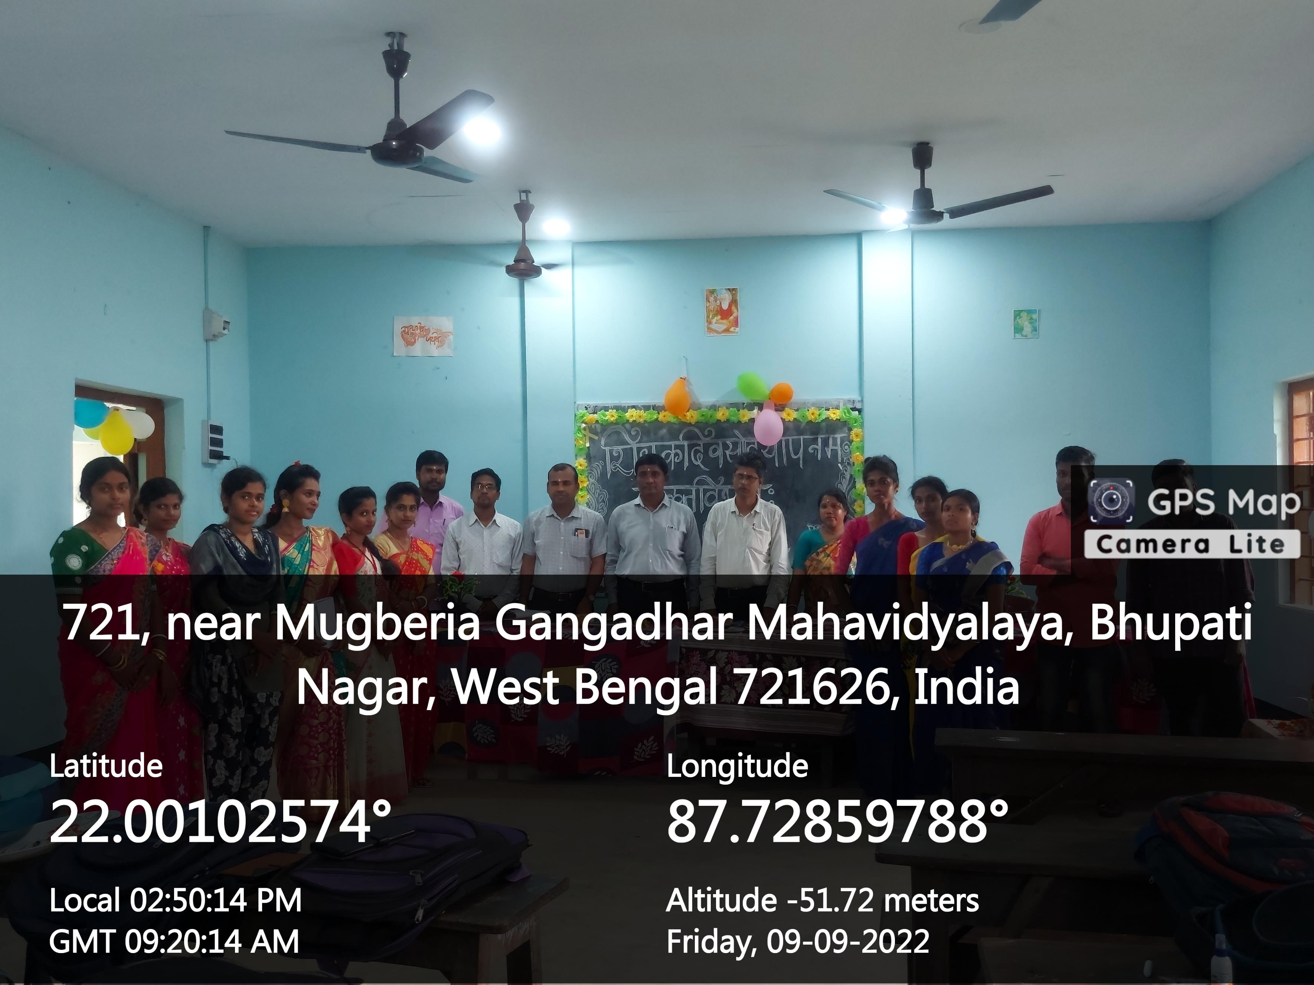

Slide 9
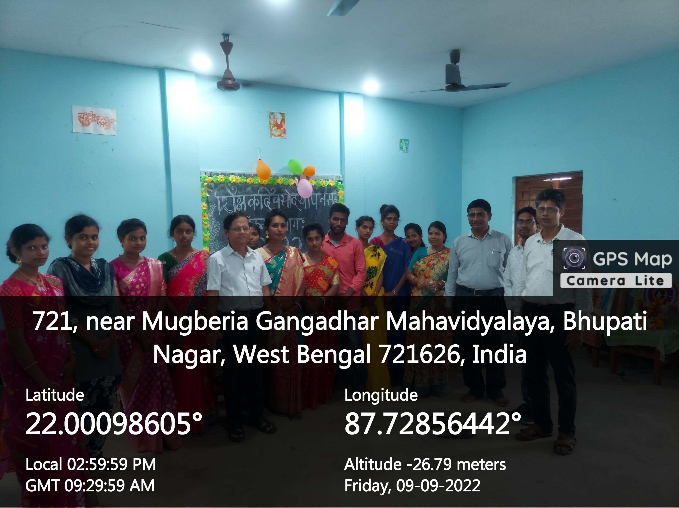
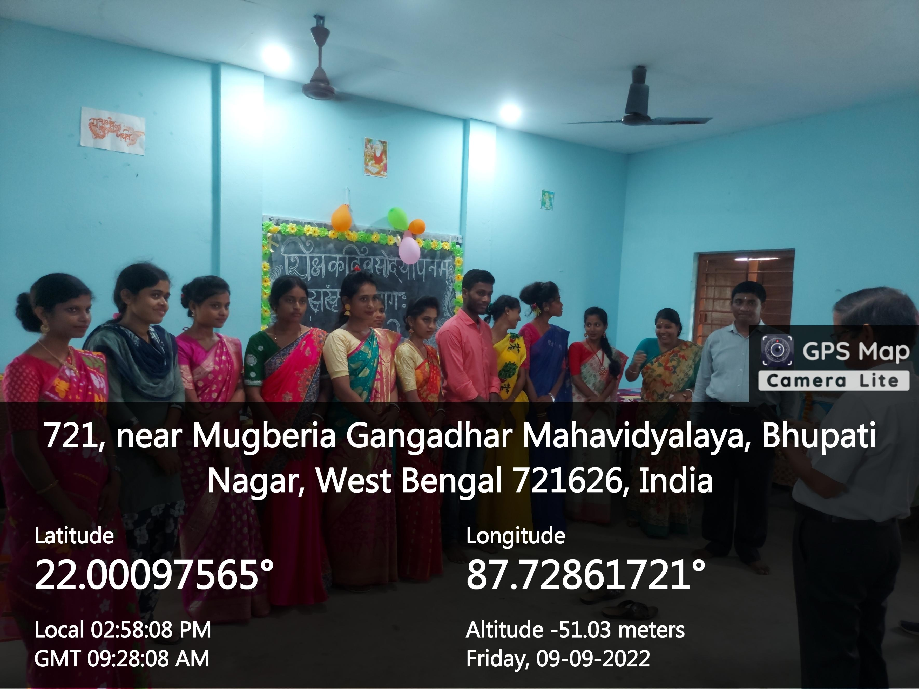

Slide 10
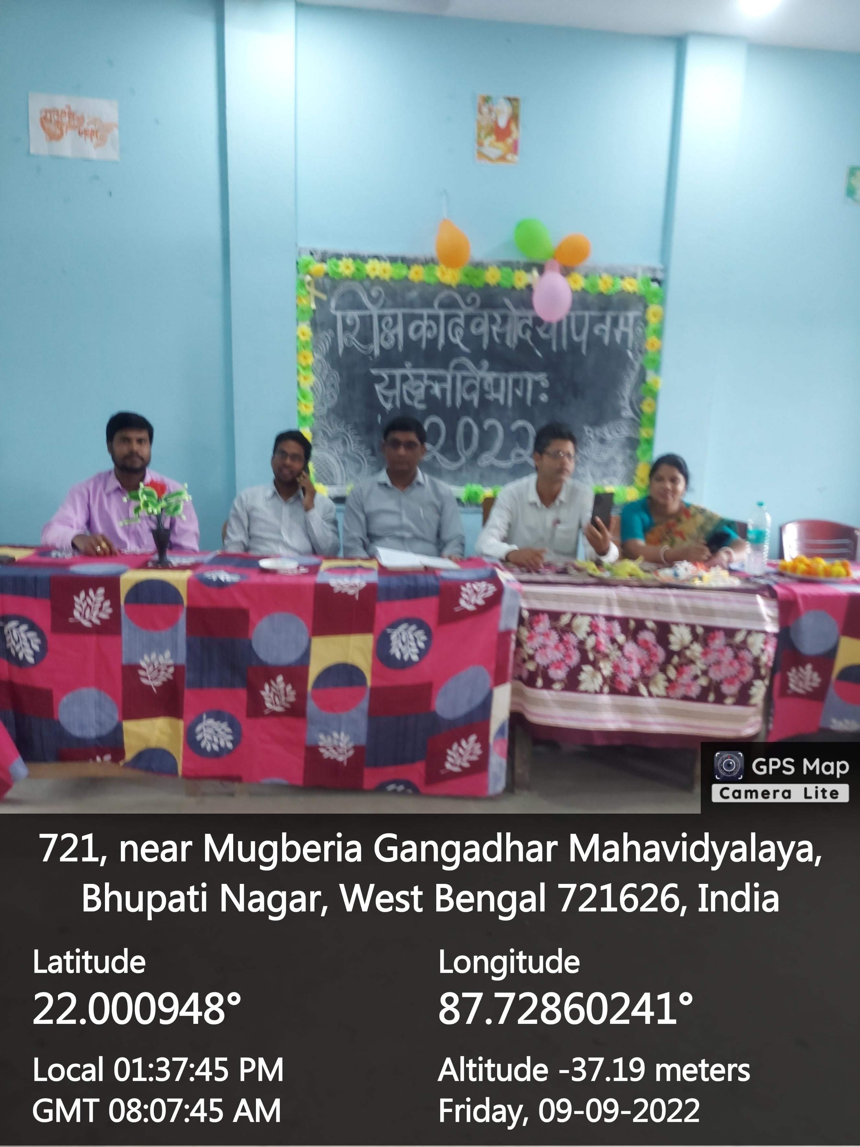

Slide 12
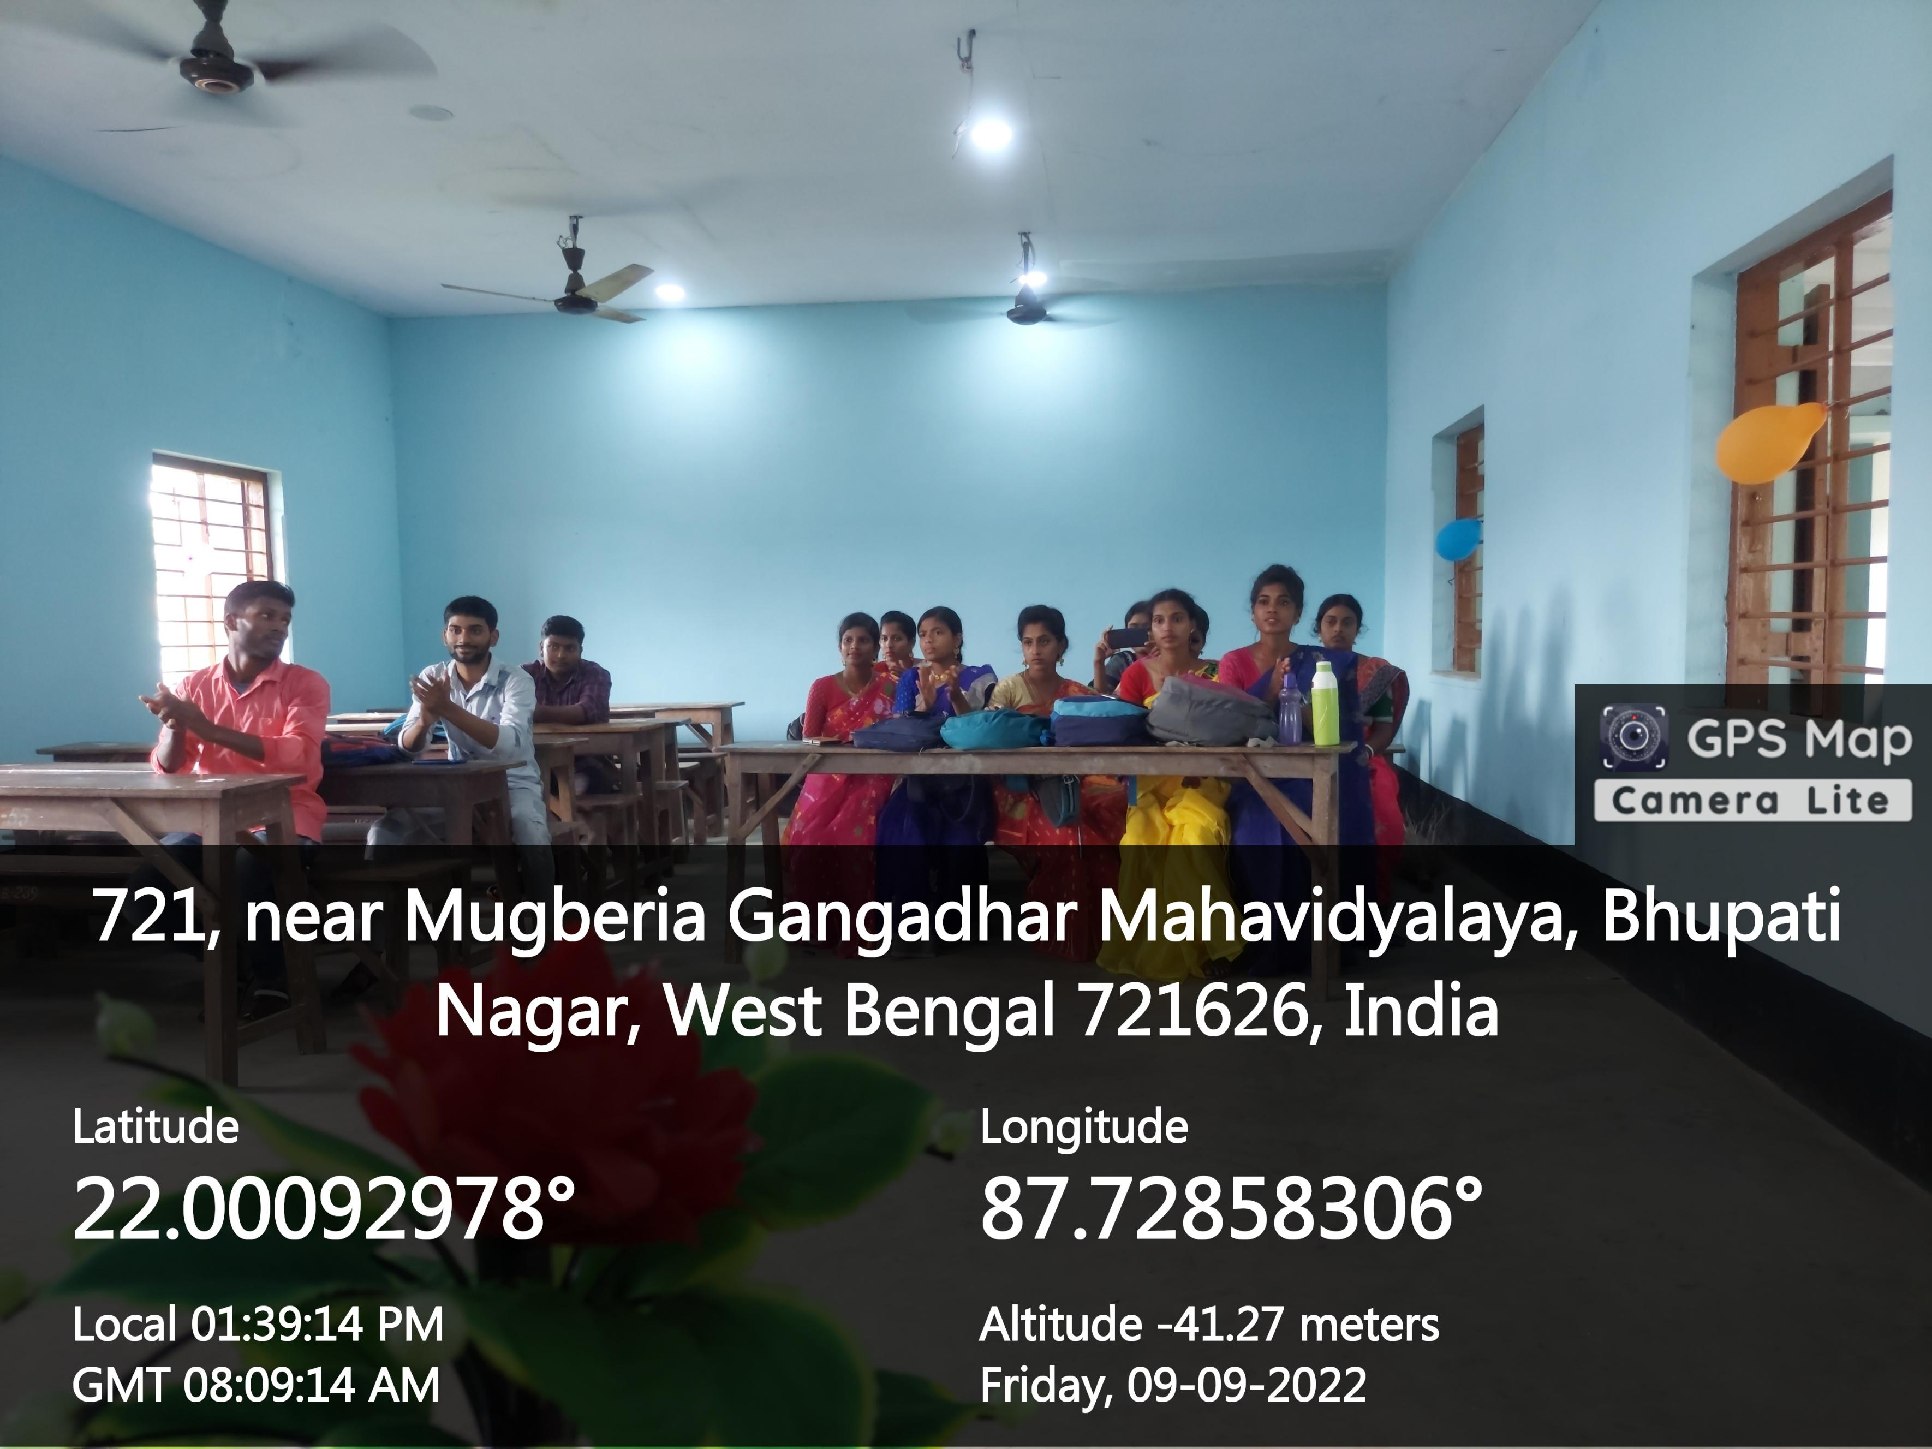

Slide 13
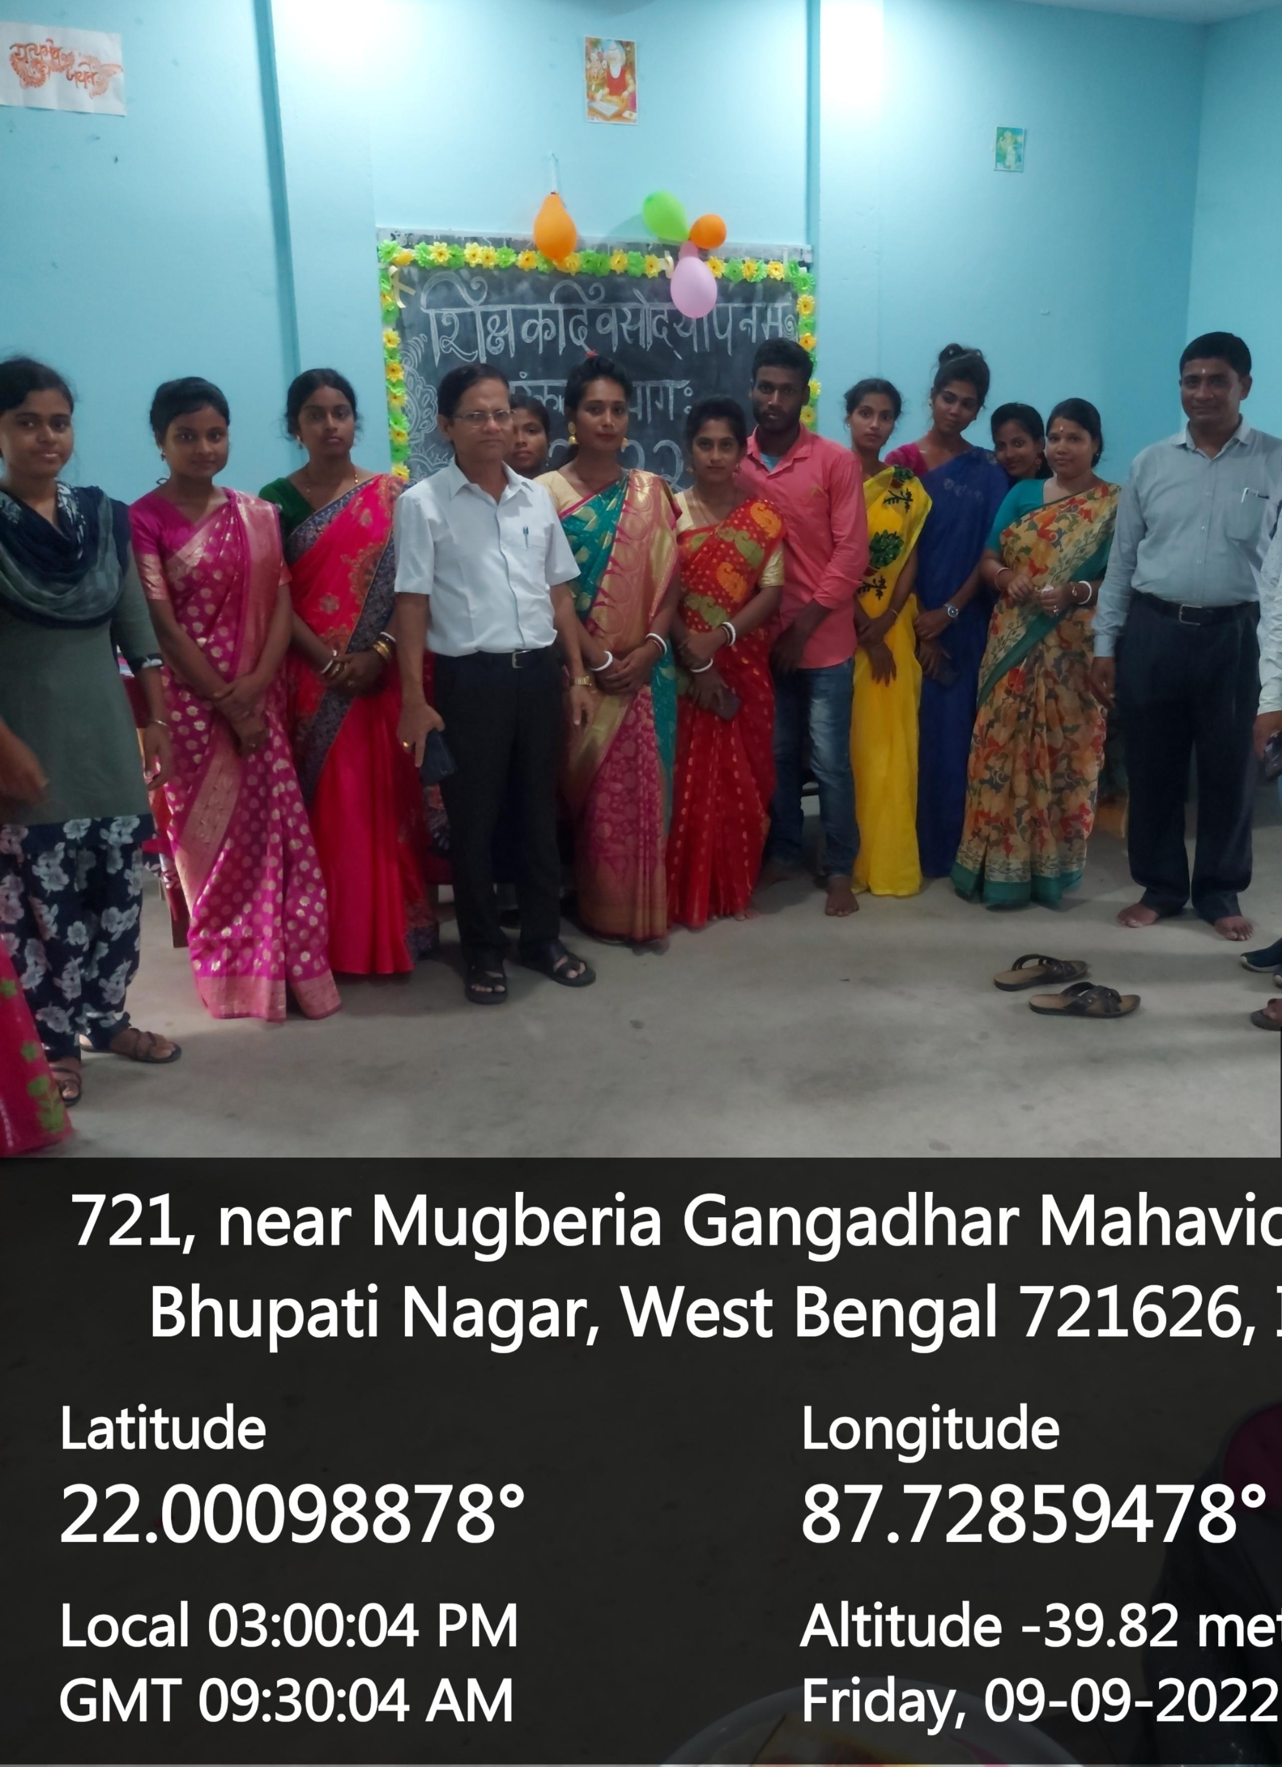

Slide 14
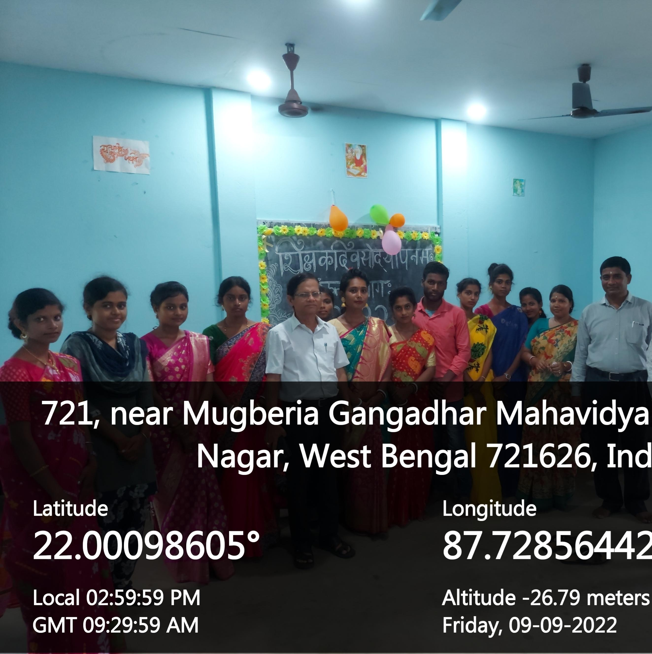

Slide 15
Thank you

